Slide 1
Formal Verification of Decentralized Coordination in Autonomous Multi-Agent Aerospace Systems
Saswata Paul, Department of Computer Science | 03/16/22
Notes:
Hello everyone, thank you for coming to today’s talk
Today I will discuss formal verification of decentralized coordination in autonomous multiagent aerospace systems

Slide 2
Contents
Introduction
Verification of Decentralized Coordination Algorithms
Eventual Progress in the Synod Consensus Algorithm
A Formally-Verified Knowledge Propagation Algorithm
Verification of Stochastic and Dynamic Distributed Systems
Reasoning about Probabilistic Properties of Distributed Algorithms
Runtime Verification of Dynamic Distributed Algorithms
Conflict-Aware Flight Planning for Multi-Aircraft Coordination
Discussion and Future Work
Notes:
The outline of the talk will be as follows:
First I will give a background on our research
And Then I will discuss the verification of decentralized coordination algorithms
After that I will talk about the verification of stochastic and dynamic distributed systems
Then I will present a conflict-aware flight planning approach for aircraft
Finally, I will conclude the talk and present some future directions of work

Slide 3
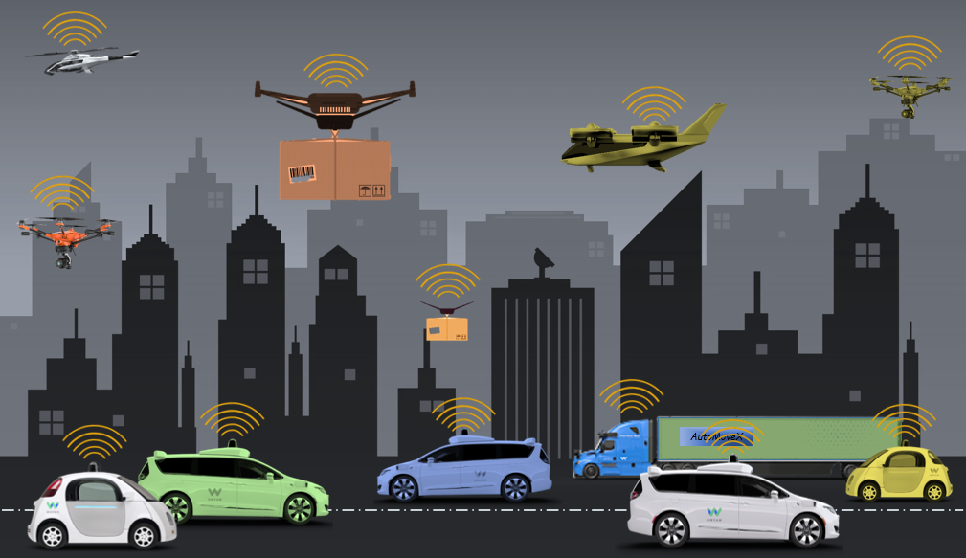
Introduction
Autonomous Multi-Agent Systems
Comprise of autonomous entities that can operate independently
E.g. - self-driving cars, Uncrewed Aircraft Systems (UAS)
Will become ubiquitous in the future
Used for passenger transportation,
package delivery, and other purposes
Will operate in close proximity
Must be capable of coordinating autonomously to ensure safe operation
Notes:
So what are autonomous multi agent systems?
Such systems are comprised of autonomous entities
Like self driving cars and uncrewed aircraft
That can operate independently
Soon, they will become commonplace
For various uses like transportation and delivery
As these agents will operate in close proximity, they must be capable of
Autonomous coordination

Slide 4


Introduction
Multi-Agent Coordination
Two models
Centralized
Coordination is easy as there is a central authority
Decentralized
Coordination is harder as there is no central authority
Decentralized coordination is more fault-tolerant
Agents can coordinate even if a few agents fail
Centralized coordination halts if the coordinator fails
Centralized coordinator becomes a bottleneck
Centralized Coordination
Decentralized Coordination
Notes:
Coordination can be done in two ways - centralized and decentralized
Centralized coordination is easy as there is a central coordinator that acts as the authority
Decentralized coordination is harder as there is no central authority
However, the decentralized approach is more fault tolerant than the centralized approach
as the agents can still coordinate if one or more agents fail
while the failure of the coordinator can stall coordination
Moreover, a coordinator also becomes a bottleneck as it has to process all messages

Slide 5
Introduction
Multi-Agent Coordination
We study the decentralized model of coordination
Autonomous vehicular systems will be ubiquitous in nature
A centralized coordinator may not always be available
Failure or lack of infrastructure
In the absence of a centralized coordinator
Operations must still be safe
The vehicles must be able to coordinate in a decentralized manner
Notes:
In this thesis, we study decentralized coordination since a centralized coordinator may not always be available for vehicular systems
In the absence of a coordinator, the vehicles must still be able to operate safely

Slide 6
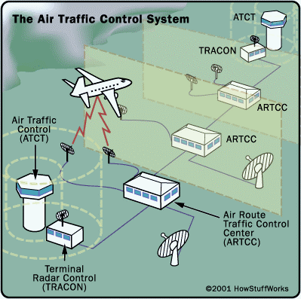

Introduction
Motivation: Autonomous Air Traffic Management (ATM)
Urban Air Mobility (UAM)
Integration of crewed and uncrewed aircraft operations in urban and semi-urban areas
Will result in high-density air traffic in the National Airspace System (NAS)
Why Autonomous ATM?
Current ATM system
Is human-controlled
Is prone to human errors
Is not scalable
Cannot be verified for correctness
Notes:
The motivation behind our work is air traffic management for urban air mobility operations which will see a significant increase in the density of aircraft in the national airspace system
As the current human-controlled system of ATM is prone to errors, not scalable, and cannot be verified, it is not appropriate for UAM

Slide 7
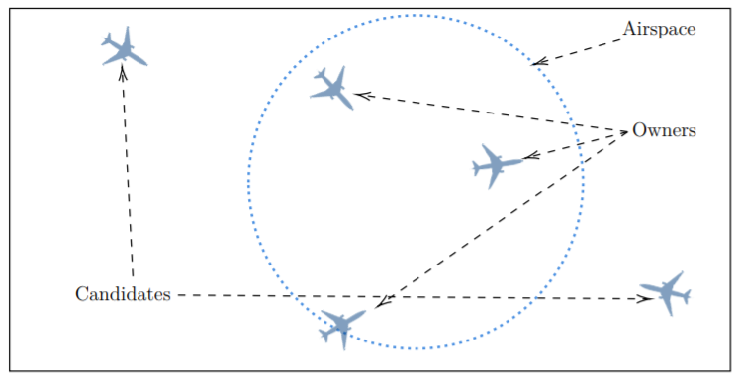
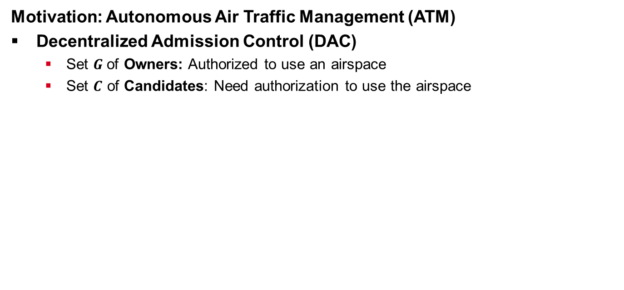
Introduction
Motivation: Autonomous Air Traffic Management (ATM)
Decentralized Admission Control (DAC)
Set $G$of Owners: Authorized to use an airspace
Set $C$ of Candidates: Need authorization to use the airspace
Notes:
As a concrete use case for our analysis,
We propose an autonomous ATM technique called Decentralized admission control in which there are two sets of aircraft
Owners have authorization to use a 4d airspace while Candidates need authorization to use the airspace

Slide 8



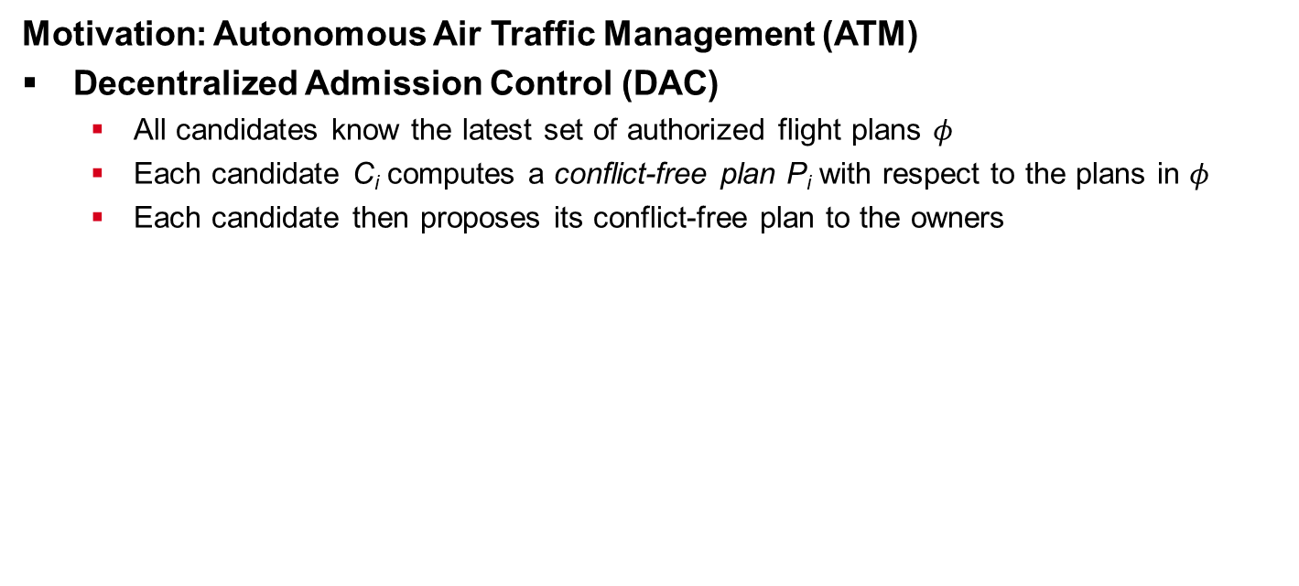
Introduction
Motivation: Autonomous Air Traffic Management (ATM)
Decentralized Admission Control (DAC)
All candidates know the latest set of authorized flight plans $φ$
Each candidate C_{i} computes a conflict-free plan P_{i} with respect to the plans in $φ$
Each candidate then proposes its conflict-free plan to the owners
Candidate 1’s proposal
Candidate 2’s proposal
Set of owners
Notes:
To get authorization,
each candidate computes a conflict-free plan with the set of authorized plans $φ$
and tries to get the owners to agree on its plan

Slide 9
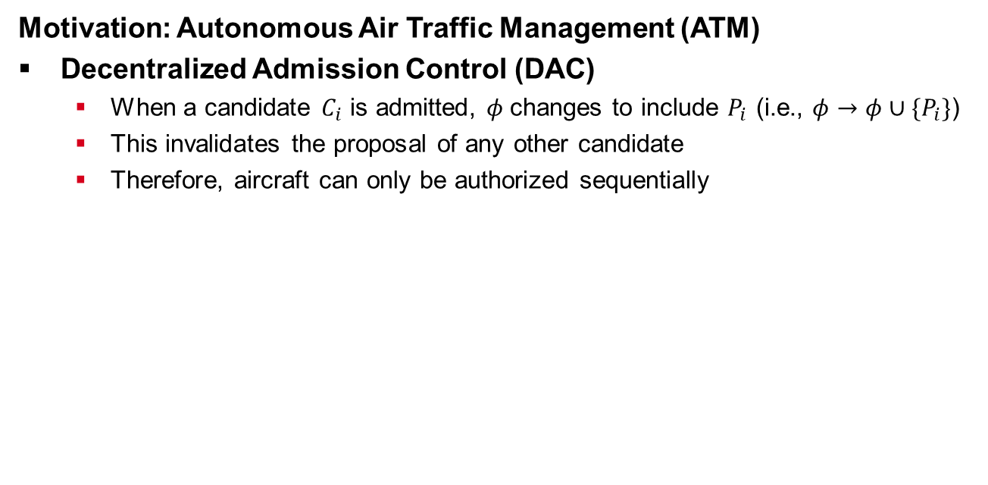
Introduction
Motivation: Autonomous Air Traffic Management (ATM)
Decentralized Admission Control (DAC)
When a candidate $C_{i}$ is admitted, $φ$changes to include $P_{i}$ (i.e., $φ→φ∪{\{P}_{i}\}$)
This invalidates the proposal of any other candidate
Therefore, aircraft can only be authorized sequentially
Candidate 1’s proposal ACCEPTED
Candidate 2’s proposal
INVALID
New set of owners
Notes:
When a new plan is authorized,
$φ$ is updated and the proposals of all other candidates become invalid
This means that aircraft can only be authorized sequentially

Slide 10
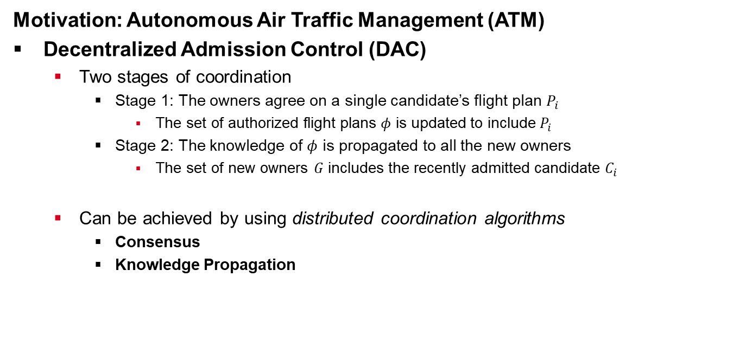
Introduction
Motivation: Autonomous Air Traffic Management (ATM)
Decentralized Admission Control (DAC)
Two stages of coordination
Stage 1: The owners agree on a single candidate’s flight plan $P_{i}$
The set of authorized flight plans $φ$ is updated to include $P_{i}$
Stage 2: The knowledge of $φ$ is propagated to all the new owners
The set of new owners $G$ includes the recently admitted candidate $C_{i}$
Can be achieved by using distributed coordination algorithms
Consensus
Knowledge Propagation
Notes:
There are two stages of coordination in DAC
-- first the owners agree on a candidate and $φ$ is updated
-- next, the new set of owners, which includes the admitted candidate, is made aware of $φ$
This can be done by using distributed coordination algorithms such as consensus and knowledge propagation

Slide 11
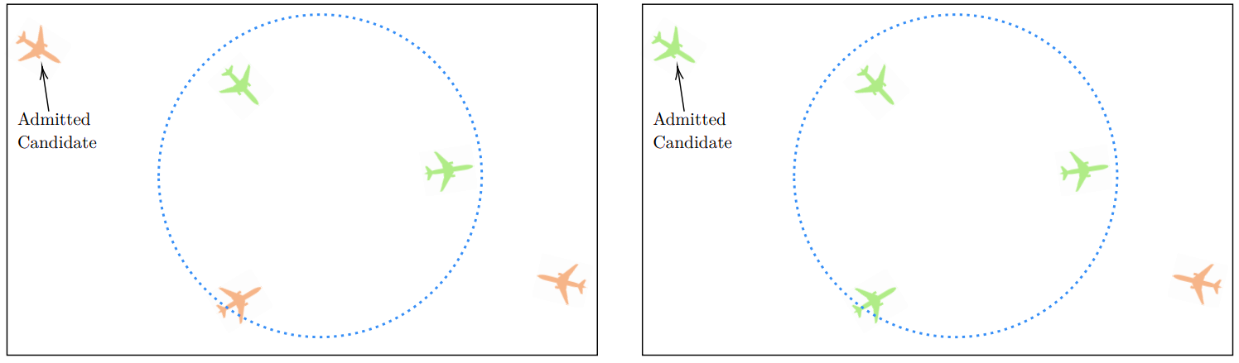
Introduction
Consensus
A set of distributed agents reach agreement on a unique value
Typically, a group of agents propose values for agreement and another group of agents vote on which value to agree on
Successful consensus only implies that a subset of the agents (called a quorum) will agree on and learn about the agreement
After consensus, a non-empty subset of agents learn of the agreement (green)
Notes:
Consensus is a fundamental problem in distributed systems where a set of agents must agree on a unique value
Usually, a group of agents propose values and another group vote on which value must be agreed upon
Successful consensus guarantees that a subset of the participating agent will agree and learn about the agreement

Slide 12
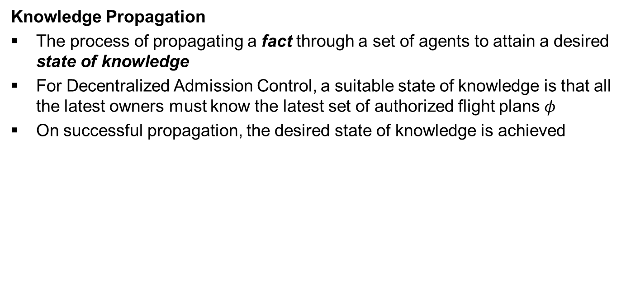
Introduction
Knowledge Propagation
The process of propagating a fact through a set of agents to attain a desired state of knowledge
For Decentralized Admission Control, a suitable state of knowledge is that all the latest owners must know the latest set of authorized flight plans $φ$
On successful propagation, the desired state of knowledge is achieved
After knowledge propagation, all the required agents learn about the value (green)
Notes:
Knowledge propagation on the other had, is the act of propagating a fact through a set of agents to attain a desired state of knowledge
In DAC, a suitable state is where all new owners know about the latest value of $φ$
Successful propagation guarantees the desired state of knowledge

Slide 13
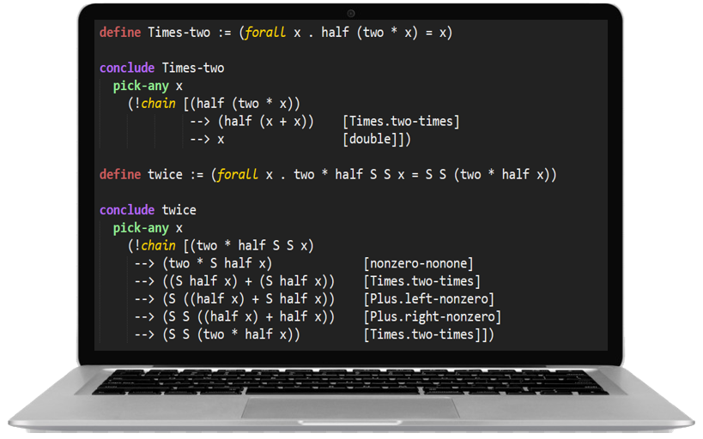
Introduction
Formal Methods
Vehicular systems are safety-critical
Algorithms used must be rigorously verified for correctness
Formal methods provide mathematical tools and techniques to rigorously verify correctness properties of systems
Model Checking
Theorem Proving
Formal proofs can be mechanically verified for correctness
Using proof assistants like Athena [Arkoudas & Musser ‘17] and
TLAPS [Chaudhari et al. ‘10]
Mechanical verification provides a high-degree of
assurance in the proofs
Notes:
Since the failure of safety-critical vehicular systems can be catastrophic,
they must be rigorously verified for correctness
Formal methods provide rigorous verification techniques such as model checking
where a model of a system is created and tested against a finite combination of inputs
And theorem proving, where proofs of correctness can be developed and mechanically verified using proof assistants.
This can provide a high degree of assurance in the proofs

Slide 14
Introduction
Challenges
Correctness guarantees required for distributed algorithms
Safety - Nothing bad will ever happen
Progress - Some desirable goal will be attained
Inter-aircraft communication will use vehicular ad-hoc networks (VANET)
The Internet of Planes (IoP) - A special VANET for airborne communication
Asynchronous in nature
Message transmission and processing delays are unknown
Agents are non-Byzantine and messages cannot be lost
Agents can fail
Impossible to differentiate from message delays in asynchronous systems
Notes:
There are several challenges involved in the verification of distributed algorithms
Firstly, the algorithms must satisfy two types of correctness properties
Safety- which implies that they will behave as intended
And progress, which implies that they will eventually achieve their goal
Secondly, autonomous vehicles are expected to communicate using ad hoc networks
For DAC, we assume an asynchronous airborne network called the Internet of planes where agents can fail
Guaranteeing correctness is hard in the IoP as factors like agents failures cannot be detected

Slide 15
Introduction
Challenges
Unpredictable and dynamic operating conditions
Cannot be modeled deterministically in advance
E.g. - message transmission and processing delays in VANETs
Formal proofs developed in the pre-deployment stages may not be relevant at runtime
The assumptions made during proof development may not be true at runtime
Not feasible to develop mechanically verified proofs of complex properties from scratch at runtime
Requires skill, expertise, and time
Notes:
Finally, vehicular systems are expected to have unpredictable and dynamic conditions that cannot be modeled deterministically
Pre-developed formal proofs may not be relevant at runtime as the assumptions used during proof development may not hold at runtime
Since developing machine-checked proofs requires considerable amount of skill and time, it is not feasible to develop them dynamically at runtime

Slide 16
Introduction
Thesis Contributions
Distributed Coordination Algorithms
The first machine-checked proof of eventual progress in the Synod consensus protocol that does not assume a unique leader [Paul et al. NFM ‘21]
A Two-Phase Acknowledge Protocol (TAP) for knowledge propagation to attain a safe state of knowledge suitable for DAC [Paul et al. DASC ‘20]
Formal Verification of Distributed Algorithms
A Failure-Aware Actor Model (FAM) to reason about temporary or permanent agent failures in VANETs [Paul et al. NFM ‘21]
Formal guarantees of probabilistic properties of timely progress for distributed algorithms deployed over VANETs [Paul et al. FMAS ‘21]
Notes:
To address these challenges, we first study specific algorithms
Where we provide the first machine-checked proof of eventual progress for the Synod consensus protocol
And then introduce a two-phase acknowledge protocol for knowledge propagation in DAC
Then we propose some general techniques for the verification of distributed algorithms
Where we introduce a failure aware actor model to reason about agent failures,
and introduce formal probabilistic properties of timely progress,

Slide 17
Introduction
Thesis Contributions
Formal Verification of Distributed Algorithms
A formal proof library in Athena that is tailored towards reasoning about distributed algorithms deployed over VANETs [Paul et al. FMAS ‘21]
A data-driven approach that allows the use of mechanically verified theorems for the runtime verification of dynamic distributed applications [Paul et al. DDDAS ‘20]
Multi-Aircraft Coordination
A formally-verified conflict-aware flight planning algorithm that can be used by candidates in DAC to compute conflict-free flight plans [Paul et al. DASC ‘19]
Notes:
We present a tailored proof library in Athena to reason about these probabilistic properties
And present a data-driven approach to use theorem proving techniques for the runtime verification of dynamic systems
Finally, we present an approach to compute conflict-free flight plans for DAC

Slide 18
Contents
Introduction
Verification of Decentralized Coordination Algorithms
Eventual Progress in the Synod Consensus Algorithm
A Formally-Verified Knowledge Propagation Algorithm
Verification of Stochastic and Dynamic Distributed Systems
Reasoning about Probabilistic Properties of Distributed Algorithms
Runtime Verification of Dynamic Distributed Algorithms
Conflict-Aware Flight Planning for Multi-Aircraft Coordination
Discussion and Future Work

Slide 19
Eventual Progress in the Synod Consensus Algorithm
A consensus algorithm must guarantee
Safety - Only one value will be agreed upon
Progress - An agreement on some value will happen
Eventual progress - Eventually, an agreement will happen
Importance of progress in Decentralized Admission Control (DAC)
Aircraft have a limited time to remain airborne
Air traffic data becomes obsolete after a short time
Our analysis of consensus is motivated by the requirements of DAC
Attaining agreement on a single candidate’s proposal is the primary goal
Multiple candidates must be allowed to compete for authorization
Notes:
In consensus, safety implies that only one value will be agreed upon and progress means that an agreement will happen
Eventual progress is a special progress property that states that eventually an agreement will happen
Progress is important for DAC because aerospace operations are time sensitive in nature
In DAC, only a single candidate must be authorized while allowing multiple candidates to compete

Slide 20
Eventual Progress in the Synod Consensus Algorithm
Synod[Lamport ‘98]
There are two logically separate sets of agents
Proposers - Propose values for being chosen (agreed upon)
Acceptors - Vote to choose a single value
A value must be approved by a quorum
A non-empty subset of the set of acceptors
Formally verified to satisfy safety if any two quorums intersect
There cannot be two quorums that vote on two different values
Notes:
The Synod algorithm consists of two sets of agents
Proposers propose values for being chosen
And acceptors vote on those values
To be chosen, a value must receive votes for a subset of acceptors called the quorum
And synod satisfies the safety property as long as any two quorums intersect

Slide 21
Eventual Progress in the Synod Consensus Algorithm
Acceptor A
Proposer A
Promise, 5
Vote, 5, v
Accept,
5, v
Prepare, 5
Accept,
5, v
Prepare, 5
Acceptor B
Promise, 5
Vote, 5, v
Proposer B
Prepare, 2
Prepare, 2
Acceptor C
Promise, 2
Notes:
From the perspective of two proposers, Synod proceeds as follows

Slide 22
Eventual Progress in the Synod Consensus Algorithm
In asynchronous communication, there is no known bound on message transmission and processing delays
Processing delays cannot be differentiated from agent failures
The Fischer, Lynch, and Paterson (FLP) impossibility result [Fischer et al. ‘85]
Consensus cannot be guaranteed under asynchronous conditions with reliable messaging if even a single agent fails unannounced
Strong assumptions about the system are required to prove progress
Progress can be affected in Synod
If all proposers fail permanently
If a quorum of acceptors is not available
If messages for every proposal are interrupted by messages corresponding to higher-numbered proposals, causing the proposals to fail (livelock)
Notes:
Since agent failures cannot be differentiated from processing delays in asynchronous communication,
The FLP impossibility result states that consensus cannot be guaranteed if even a single agent fails arbitrarily
In Synod, progress may be affected if even a single agent arbitrarily fails or if every proposal is interrupted by higher-numbered proposals

Slide 23
Eventual Progress in the Synod Consensus Algorithm
We have identified a fundamental condition for progress in Synod
CND - Eventually, some nonfaulty proposer will be ready to propose some proposal number, that will satisfy the non-interruption condition, to a quorum of nonfaulty acceptors
A nonfaulty agent is an agent that eventually performs all desired actions
The non-interruption condition implies that the messages for the proposal number will not be interrupted by messages for higher-numbered proposals
Notes:
We have identified that the fundamental condition for progress is that
Eventually, some non-faulty proposer must become ready to propose some proposal number,
that will not be interrupted,
to a nonfaulty quorum
Here, a nonfaulty agent is an agent that eventually performs all actions that it is supposed to

Slide 24
Eventual Progress in the Synod Consensus Algorithm
The actor model[Hewitt ’77, Agha ‘86] is a model of concurrent computation
Actors communicate by passing messages asynchronously
The actor model assumes fairness, which is helpful to reason about progress
Agha, Mason, Smith, & Talcott presented an actor language (AMST)[Agha et al. ‘97]
Allows modeling distributed algorithms deployed over asynchronous networks
Our analysis of eventual progress in Synod considers agent failures
AMST does not support modeling actor failures
Notes:
To reason about progress in Synod, we use the actor model
Actors are entities that communicate by passing messages asynchronously
and fairness in the actor model is useful for reasoning about progress
The actor language AMST can be used to model asynchronous distributed systems
But it does not allow modeling agent failures

Slide 25
Eventual Progress in the Synod Consensus Algorithm
A Novel Failure-Aware Actor Model (FAM)
Consequences of fairness in FAM
Guaranteed message delivery
An actor infinitely often enabled to process a message eventually processes it
A predicate that is infinitely often enabled in a given path will eventually be satisfied (Predicate fairness[Queille & Sifakis ‘83])
FAM allows two states for actors at any given point of time
Available - Can send and receive messages, perform local computations, and create new actors
Failed - Cannot send and receive messages, perform local computations, or create new actors
Notes:
Therefore,
we propose a novel Failure Aware actor model that supports reasoning about actor failures
Fairness in FAM implies three things:
message delivery is guaranteed,
An actor infinitely often ready to process a message will eventually process it
And a predicate that is infinitely often enabled will eventually be true
FAM allows two states for an actor at any given time
Available or failed
An available actor can send and received messages and perform other tasks, while a failed actor cannot

Slide 26
Eventual Progress in the Synod Consensus Algorithm
We modify Varela’s dialect[Varela ‘13] of AMST to model FAM
Has four transitions
fun - functional computation
new - new actor creation
snd - sending a message
rcv - receiving a message
We introduce two additional transitions
stp - stops an available actor
bgn - starts a failed actor in persistent pre-failure state
In FAM, fun, new, snd, and rcv are base-level transitions while stp and bgn are meta-level transitions
Only the base-level transitions satisfy the fairness properties as the meta-level transitions can be unpredictable
Notes:
To model FAM, We modify Varela’s dialect of AMST that has four base-level transitions
Fun for functional computation
New for new actor creation
Send for message sending
And rcv for message reception
We introduce two new meta-level transitions stp and begin
That can stop an available actor or
Restart a failed actor
In FAM, only the base-level transitions follow fairness in FAM as the meta level transitions can be unpredictable

Slide 27
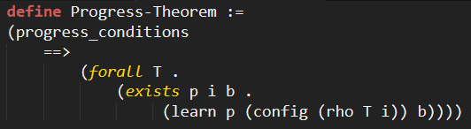
Eventual Progress in the Synod Consensus Algorithm
Our eventual progress theorem
Given the conditions for progress (CND), in all fair transition paths, eventually some proposer p will learn that some proposal number b has been chosen
Formally verified using Athena[Arkoudas & Musser ‘17]
Notes:
Using FAM, we have verified our progress guarantee which states that
Given the conditions, eventually some proposer will learn that some proposal number has been chosen
This guarantee has been machine checked in Athena

Slide 28
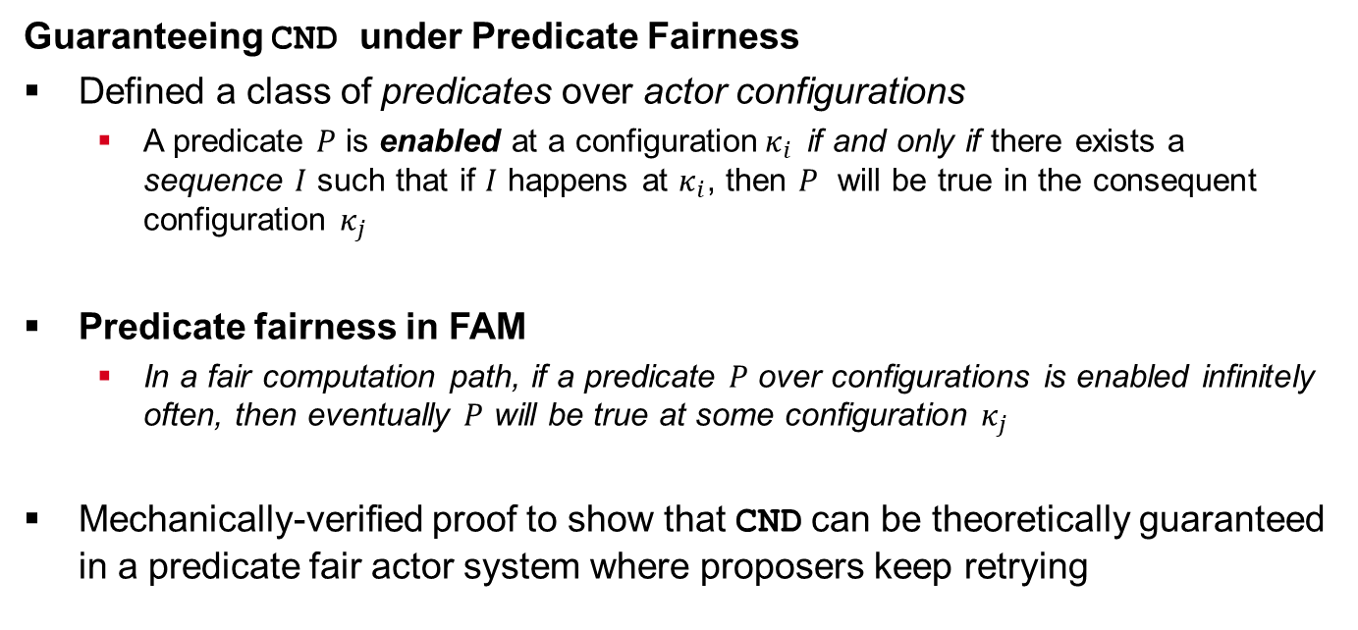
Eventual Progress in the Synod Consensus Algorithm
Guaranteeing CND under Predicate Fairness
Defined a class of predicates over actor configurations
A predicate $P$ is enabled at a configuration$κ_{i}$ if and only if there exists a sequence $I$ such that if $I$ happens at $κ_{i}$, then $P$ will be true in the consequent configuration $κ_{j}$
Predicate fairness in FAM
In a fair computation path, if a predicate $P$ over configurations is enabled infinitely often, then eventually $P$ will be true at some configuration $κ_{j}$
Mechanically-verified proof to show that CND can be theoretically guaranteed in a predicate fair actor system where proposers keep retrying
Notes:
Furthermore, we have also provided a machine checked proof
to show that the conditions for progress can be guaranteed under predicate fairness
To do that, we defined a class of predicates over actor configurations
Such a predicate is enabled at a configuration kappa_i if and only if there exists a sequence I such that if I happens at kapa_i, then the predicate will be true at the consequent configuration kappa_j
We then defined predicate fairness in FAM as
In all fair transition paths, a predicate over configurations that is infinitely often enabled will eventually be true at some configuration

Slide 29
Eventual Progress in the Synod Consensus Algorithm
Advantages
The identified asynchronous conditions for eventual progress in Synod
Do not impose proposal restrictions
Do not require leader election as a precondition
The Failure-Aware Actor Model allows reasoning about agent failures in VANETs
The first machine-checked proof of eventual progress in Synod
Limitations
Eventual progress guarantee does not provide any time bound
Insufficient for time-critical UAM applications
Does not model Byzantine or adversarial agents
Notes:
To summarize,
Our conditions for progress in Synod
do not impose proposal restrictions
or require leader election as a precondition
The failure-aware actor model allows formal reasoning about actor failures in VANETs
And we have presented the first machine checked proof of eventual progress in Synod
However, since eventual progress does not provide any time bounds, it is not sufficient for time-critical applications
Moreover, the assumptions do not consider Byzantine or adversarial agents

Slide 30
Contents
Introduction
Verification of Decentralized Coordination Algorithms
Eventual Progress in the Synod Consensus Algorithm
A Formally-Verified Knowledge Propagation Algorithm
Verification of Stochastic and Dynamic Distributed Systems
Reasoning about Probabilistic Properties of Distributed Algorithms
Runtime Verification of Dynamic Distributed Algorithms
Conflict-Aware Flight Planning for Multi-Aircraft Coordination
Discussion and Future Work

Slide 31
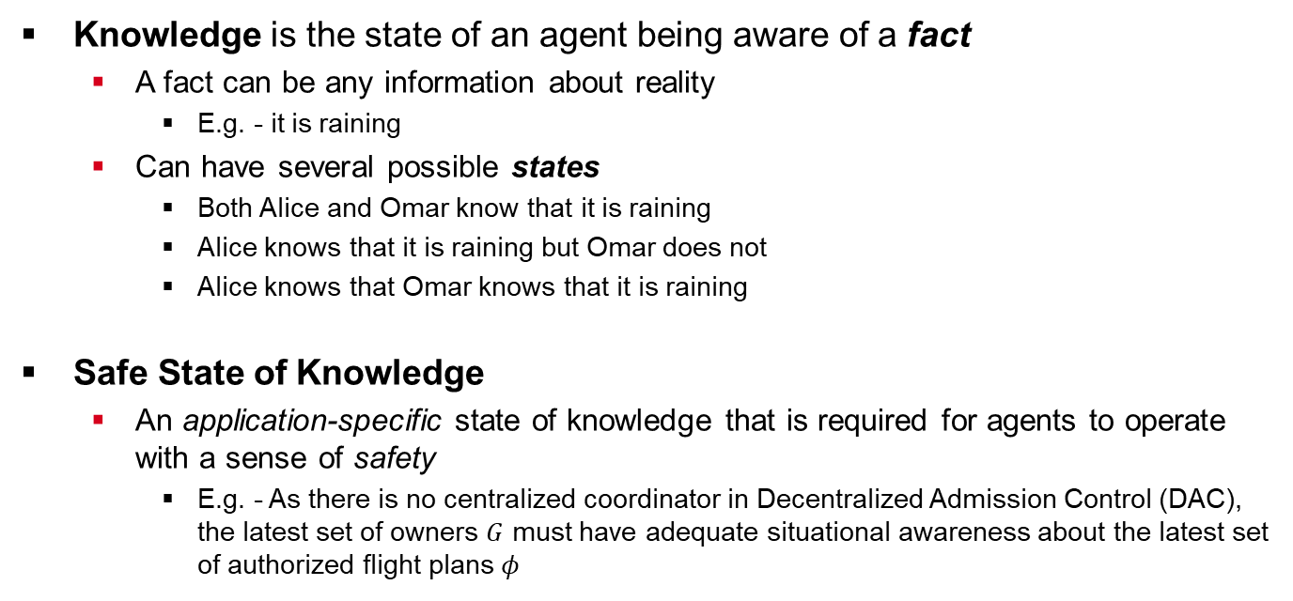
A Formally-Verified Knowledge Propagation Algorithm
Knowledge is the state of an agent being aware of a fact
A fact can be any information about reality
E.g. - it is raining
Can have several possible states
Both Alice and Omar know that it is raining
Alice knows that it is raining but Omar does not
Alice knows that Omar knows that it is raining
Safe State of Knowledge
An application-specific state of knowledge that is required for agents to operate with a sense of safety
E.g. - As there is no centralized coordinator in Decentralized Admission Control (DAC), the latest set of owners $G$ must have adequate situational awareness about the latest set of authorized flight plans $φ$
Notes:
Knowledge can be defined as the state of an agent being aware of a fact
where a fact can be something like “it is raining”
In a group of agents, knowledge can have several states
For example, considering two agents Alice and Omar, some states can be that
Both alice and omra know it is raining or
Alice knows that omar knows that it is raining
A safe state of knowledge is an application-specific state that is required for agents to operate safely
Since there is no coordinator in DAC, the latest group of owners should always be aware of the latest set of authorized plans

Slide 32
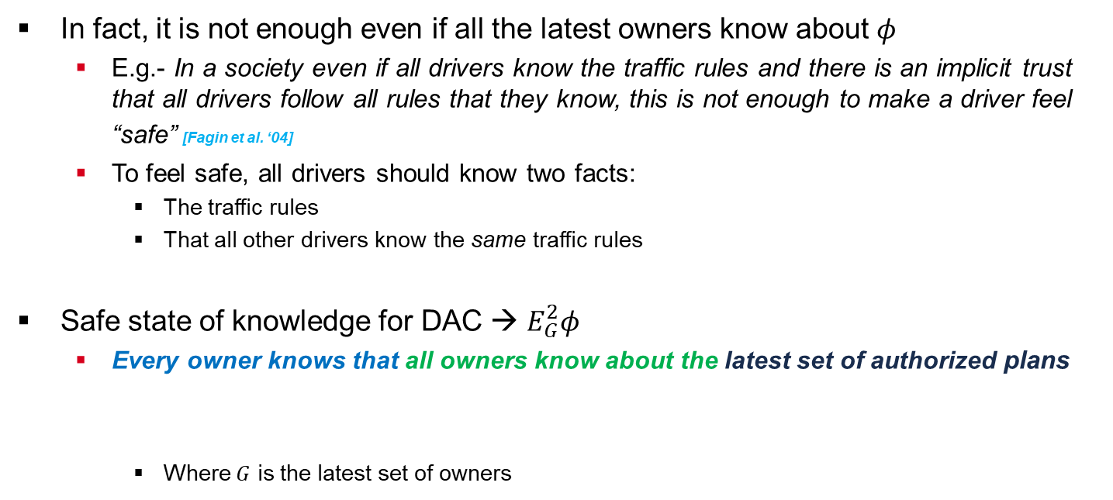
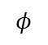
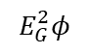
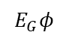
A Formally-Verified Knowledge Propagation Algorithm
In fact, it is not enough even if all the latest owners know about $φ$
E.g.- In a society even if all drivers know the traffic rules and there is an implicit trust that all drivers follow all rules that they know, this is not enough to make a driver feel “safe” [Fagin et al. ‘04]
To feel safe, all drivers should know two facts:
The traffic rules
That all other drivers know the same traffic rules
Safe state of knowledge for DAC → $E_{G}^{2}φ$
Every owner knows that all owners know about the latest set of authorized plans
Where $G$ is the latest set of owners
$$φ$$
$$E_{G}φ$$
$$E_{G}^{2}φ$$
Notes:
In fact, it is not enough even if all owners know about $φ$
For example, in a society, even if all drivers know the traffic rules and there is an implicit trust that all drivers will follow any rules that they know,
to feel safe, a driver needs to know that all other drivers know the same rules
Therefore, we define a safe state for DAC as E2GPhi
where Phi is the latest set of authorized plans
EGphi represents that all owners know phi
And E2GPhi represents that all owners know that all owners know Phi

Slide 33
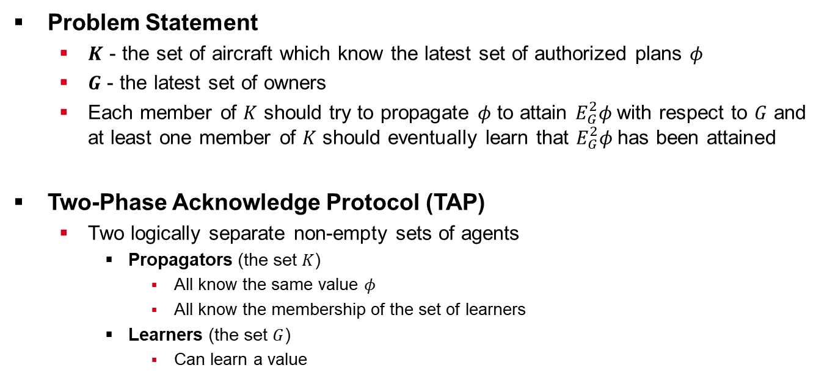
A Formally-Verified Knowledge Propagation Algorithm
Problem Statement
$K$ - the set of aircraft which know the latest set of authorized plans 𝜙
$G$ - the latest set of owners
Each member of $K$ should try to propagate 𝜙 to attain $E_{G}^{2}φ$with respect to $G$ and at least one member of $K$ should eventually learn that $E_{G}^{2}φ$has been attained
Two-Phase Acknowledge Protocol (TAP)
Two logically separate non-empty sets of agents
Propagators (the set $K$)
All know the same value $φ$
All know the membership of the set of learners
Learners (the set $G$)
Can learn a value
Notes:
The problem statement for knowledge propagation in DAC
can be stated in terms of two sets K and G
Where K is the set of agents that know phi
And G is the set of owners
All agents in K must try to propagate phi to attain E2Gphi and at least one member of K should learn that E2GPhi has been attained
We present a Two Phase acknowledge protocol that has two logically separate sets of agents
Propagators know the same value Phi and the set of learners
And Learners can learn a value

Slide 34
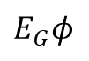
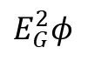
A Formally-Verified Knowledge Propagation Algorithm
Phases of TAP
Propagator
Learner
Propagator
Learnt ø
Learnt ø
Learn
ø
Learn
ø
Ack
Propagator
Learner
Learn
ø
Learnt ø
Learn
ø
Learnt ø
All Know ø
All Know ø
Ack
$$E_{G}^{2}φ$$
$$E_{G}φ$$
Notes:
From the perspective of a single propagator TAP proceeds as follows

Slide 35
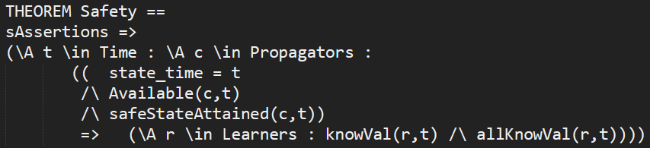
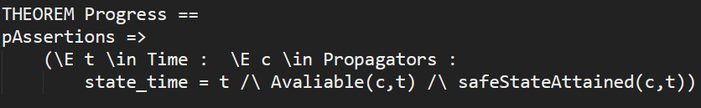
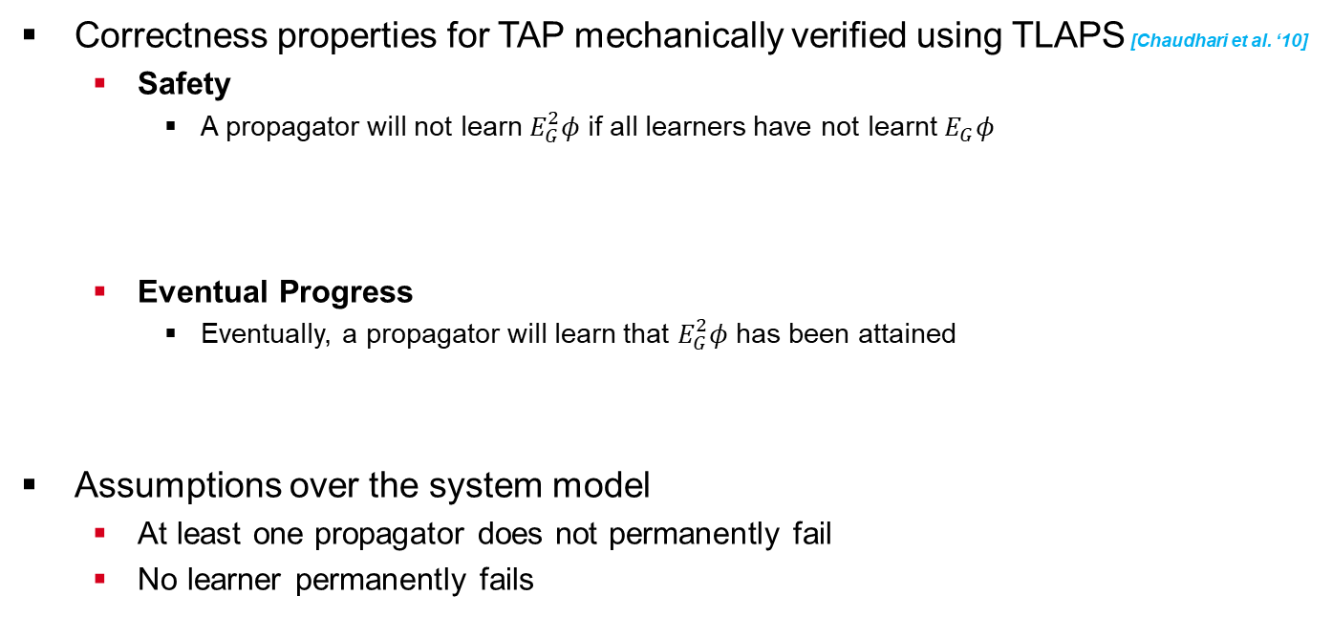
A Formally-Verified Knowledge Propagation Algorithm
Correctness properties for TAP mechanically verified using TLAPS [Chaudhari et al. ‘10]
Safety
A propagator will not learn $E_{G}^{2}φ$ if all learners have not learnt $E_{G}φ$
Eventual Progress
Eventually, a propagator will learn that $E_{G}^{2}φ$ has been attained
Assumptions over the system model
At least one propagator does not permanently fail
No learner permanently fails
Notes:
We have mechanically verified two correctness properties for TAP using TLAPS
Safety states that a propagator will not learn E2GPhi if all learners have not learnt EGPhi
Eventual progress states that eventually a propagator will learn E2GPhi
To prove these properties, we had to assume that
no replica can permanently fail and at least one propagator will not permanently fail

Slide 36
A Formally-Verified Knowledge Propagation Algorithm
Advantages
TAP propagates the knowledge of consensus to all owners to attain a safe state of knowledge suitable for DAC
TAP has been mechanically verified for safety-critical aerospace applications
Limitations
Cannot tolerate the permanent failure of even one learner
Guarantee of eventual progress is insufficient for time-critical applications
Does not consider Byzantine or adversarial agents
Notes:
So, the advantages of TAP are that
It can attain a suitable state of knowledge for DAC
and it has been mechanically verified for correctness
However, TAP cannot tolerate the failure of even one learner
And like Synod, a guarantee of eventual progress is not sufficient
and we have not considered Byzantine or adversarial agents

Slide 37
Contents
Introduction
Verification of Decentralized Coordination Algorithms
Eventual Progress in the Synod Consensus Algorithm
A Formally-Verified Knowledge Propagation Algorithm
Verification of Stochastic and Dynamic Distributed Systems
Reasoning about Probabilistic Properties of Distributed Algorithms
Runtime Verification of Dynamic Distributed Algorithms
Conflict-Aware Flight Planning for Multi-Aircraft Coordination
Discussion and Future Work

Slide 38
Probabilistic Properties of Distributed Algorithms
Properties of eventual progress do not provide any useful time bounds
Necessary to have timely progress properties that provide time bounds
The operating conditions of distributed algorithms deployed over VANETs cannot be deterministically predicted
Message transmission delays in the network
Message processing delays in the network
Deterministic properties of timely progress not possible
E.g. - Consensus will happen in under 1 second
We introduce probabilistic properties of timely progress
E.g. - Consensus will happen in under 1 second with 99.99999% probability
Notes:
Until now, we have only talked about eventual progress that does not provide any time bounds
But it is a necessary precondition for guaranteeing timely progress
However, since distributed algorithms deployed over VANETs operate in unpredictable conditions,
It is not possible to provide deterministic properties such as “consensus will take at most 1 second”
Therefore, we introduce ways to provide guarantees of probabilistic properties of timely progress
Such as “consensus will take at most 1 second with 99.9999% probability“
that can still be useful

Slide 39
Probabilistic Properties of Distributed Algorithms
Probabilistic properties of timely progress
Generated by stochastically modeling the operating conditions
Theoretical models
Data-driven models
Models must be appropriate for vehicle-to-vehicle (V2V) communication
Nature of V2V communication via VANETs
Agents are mobile and may not always be able to communicate with each other
Message transmission may require relaying when the source and the destination are unable to communicate directly
Messages received by an agent must be placed in queues until they can be processed
Notes:
Such properties can be derived by stochastically modeling the conditions
Using theoretical or data-driven models
Theoretical models are based on analytical properties while
Data driven models are based on real-time or historical observations
Since vehicle to vehicle communication is affected by several factors such as the mobility of agents,
appropriate models must be used
For example, in situations where a source and destination are not in direct transmission range, relaying can be used
And inside each aircraft, a queue may be implemented to process the incoming messages

Slide 40
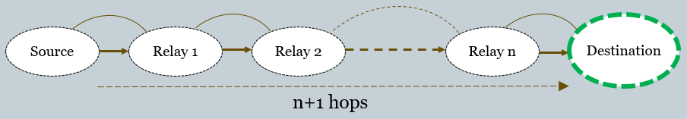
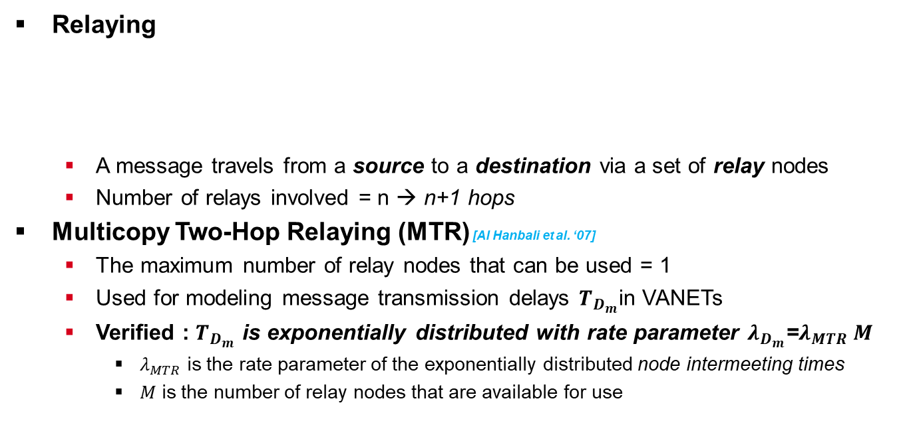
Probabilistic Properties of Distributed Algorithms
Relaying
A message travels from a source to a destination via a set of relay nodes
Number of relays involved = n → n+1 hops
Multicopy Two-Hop Relaying (MTR) [Al Hanbali et al. ‘07]
The maximum number of relay nodes that can be used = 1
Used for modeling message transmission delays $T_{D_{m}}$in VANETs
Verified : $T_{D_{m}}$ is exponentially distributed with rate parameter $λ_{D_{m}}$=$λ_{MTR} M$
$λ_{MTR}$ is the rate parameter of the exponentially distributed node intermeeting times
$M$ is the number of relay nodes that are available for use
Notes:
To model message transmission delays in VANETs,
We use theory from relaying protocols
where a message can be transmitted between a source and a destination
Via one or more relay nodes
If n relay nodes are used, then the message is said to have made n+1 hops
We specifically model the MTR protocol where messages can make a maximum of two hops
And mechanically prove that the transmission time is exponentially distributed with the rate parameter lambda_MTR_M
Where lambda_mtr is the rate parameter of the node intermeeting times
And M is the number of relay nodes available for use

Slide 41
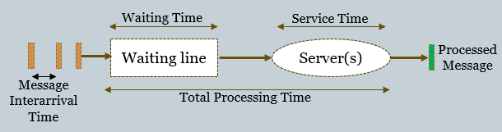
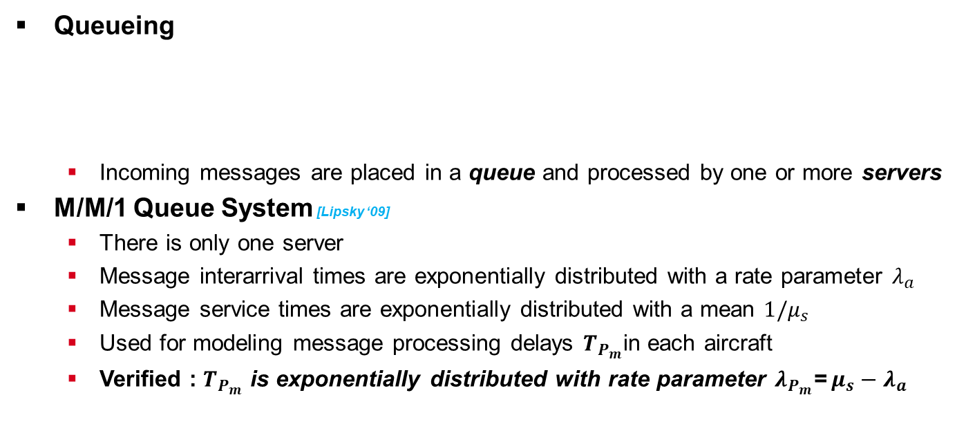
Probabilistic Properties of Distributed Algorithms
Queueing
Incoming messages are placed in a queue and processed by one or more servers
M/M/1 Queue System [Lipsky ‘09]
There is only one server
Message interarrival times are exponentially distributed with a rate parameter $λ_{a}$
Message service times are exponentially distributed with a mean $1/μ_{s}$
Used for modeling message processing delays $T_{P_{m}}$in each aircraft
Verified : $T_{P_{m}}$ is exponentially distributed with rate parameter $λ_{P_{m}}$=$μ_{s}−λ_{a}$
Notes:
To model message processing delays, we use theory of queueing systems
where messages are stored in a buffer until they can be processed by one or more servers
We use the M/M/1 queueing system where
There is only one server
And the message interarrival and service times are exponentially distributed with the rate parameters
Lambda_a and mu_s
And mechanically verify that the processing times will be exponentially distributed with the rate mu_s - lambda_a

Slide 42
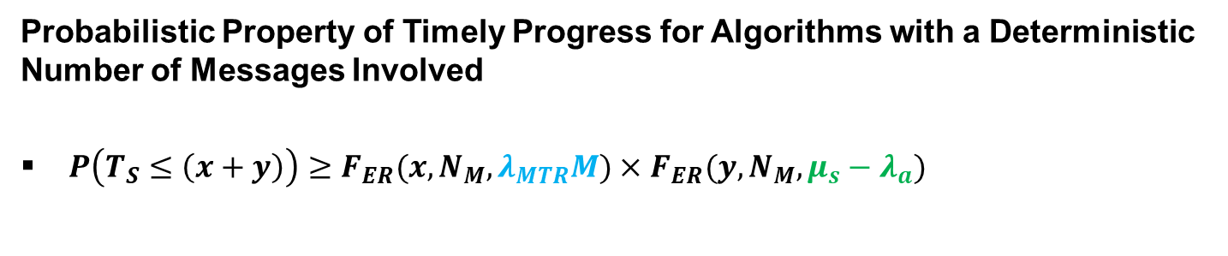
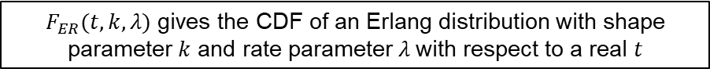
Probabilistic Properties of Distributed Algorithms
Probabilistic Property of Timely Progress for Algorithms with a Deterministic Number of Messages Involved
$P\left(T_{S}≤\left(x+y\right)\right)≥{F_{ER}(x, N_{M}, λ}_{MTR}M)×$ $F_{ER}(y, N_{M}, μ_{s}−λ_{a})$
Total time for progress
Number of messages
Rate parameter of transmission delays
Rate parameter of processing delays
$F_{ER}(t,k,λ)$ gives the CDF of an Erlang distribution with shape parameter $k$ and rate parameter $λ$with respect to a real $t$
Notes:
Using the probabilistic properties of delays in the MTR protocol and M/M/1 queues,
We have derived a probabilistic progress property for distributed algorithms with a
Deterministic number of messages N_M
In this property shown, F_ER(t,k,lambda) represents the CDF of an erlang distribution with rate parameter lambda and shape parameter k

Slide 43
Probabilistic Properties of Distributed Algorithms
A Proof Library in Athena
Mechanically verifying higher-level properties of complex systems requires domain-specific formal constructs to express properties and systems
E.g. - expressing the node mobility model for a relaying protocol
E.g. - expressing the parameters of a queueing system
E.g. - expressing the specification of a distributed protocol like TAP
Developing expressive domain-specific constructs requires
Domain knowledge of all aspects of the system to be modeled
Expertise in formal logic and reasoning techniques
Mastery in a machine-checkable formal language
Significant time and effort
Notes:
Mechanically verifying such complex probabilistic properties requires access to logical constructs
That can be used to represent domain specific concepts such as mobility models, relaying protocols, etc
Such constructs are difficult to develop from scratch as it requires
Domain-knowledge,
expertise in formal reasoning techniques,,
Mastery in a machine-checkable language,
And significant time and effort

Slide 44
Probabilistic Properties of Distributed Algorithms
A Proof Library in Athena
Beneficial to have a library of pre-developed formalizations that can be used as a foundation to develop higher-level specifications and proofs
Well-organized theories that can be used in different contexts to specify domain-specific constructs during proof development
We have developed a formal library in Athena that is tailored towards reasoning about distributed algorithms in airborne VANETs
Can express concepts from
General mathematics and probability
Communication networks
Queues and relaying protocols
Distributed algorithms
Notes:
Therefore, having a pre-developed library of domain-specific constructs
that can be used in different contexts during proof development
Just like libraries of traditional programming languages
Can be very useful for verification
We have developed such a library in Athena that is tailored towards distributed algorithms deployed over VANETs
Which allows us to express concepts from domains such as
mathematics,
relaying protocols,
Queues,
And distributed systems

Slide 45
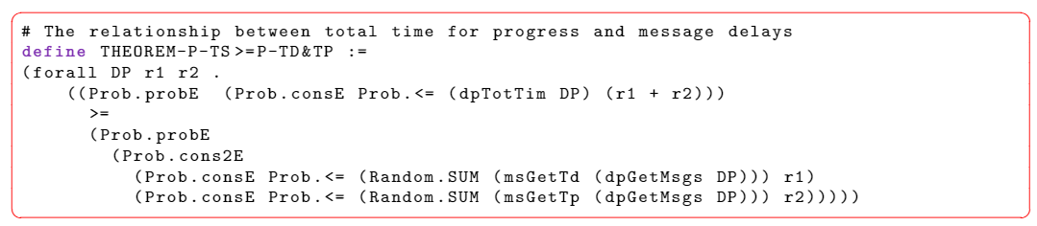
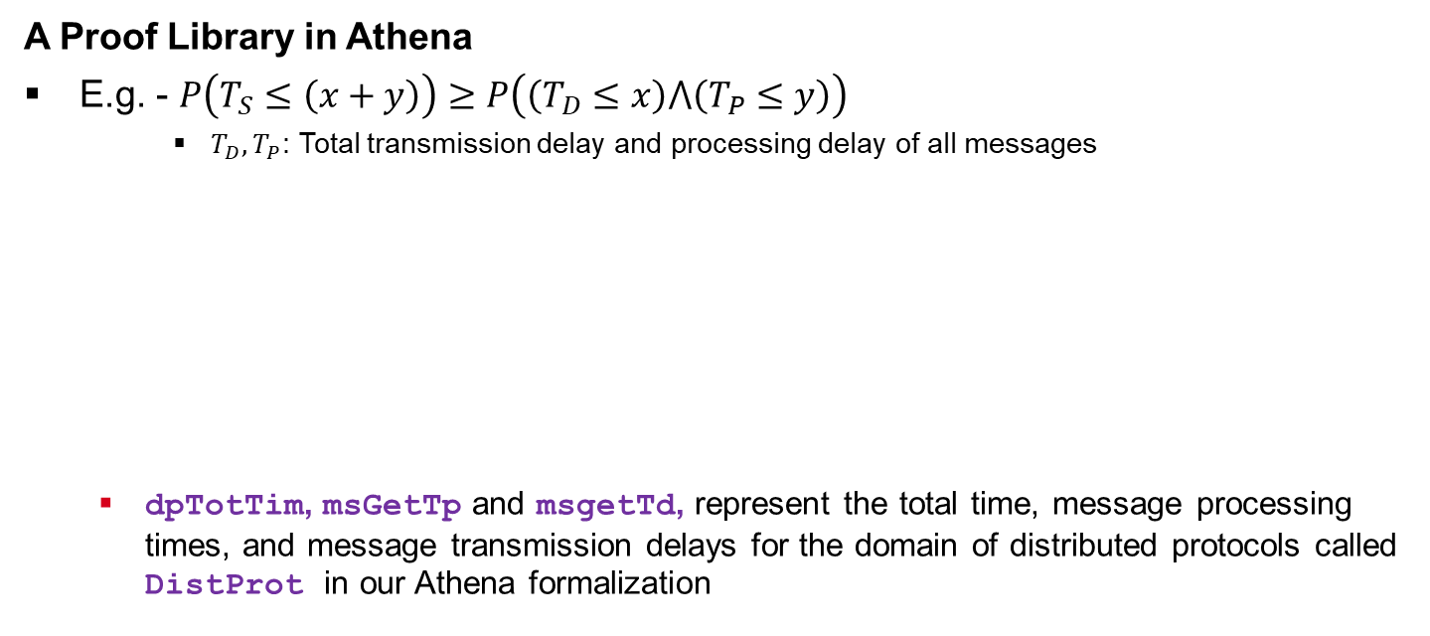
Probabilistic Properties of Distributed Algorithms
A Proof Library in Athena
E.g. - $P\left(T_{S}≤\left(x+y\right)\right)≥P\left(\left(T_{D}≤x\right)⋀\left(T_{P}≤y\right)\right)$
$T_{D}, T_{P}$: Total transmission delay and processing delay of all messages
dpTotTim, msGetTp and msgetTd, represent the total time, message processing times, and message transmission delays for the domain of distributed protocols called DistProt in our Athena formalization
Notes:
Here we can see an example of a probabilistic property related to timely progress
That uses our Athena constructs for expressing concepts such as
the total time for progress,
Message transmission times,
And message processing times

Slide 46
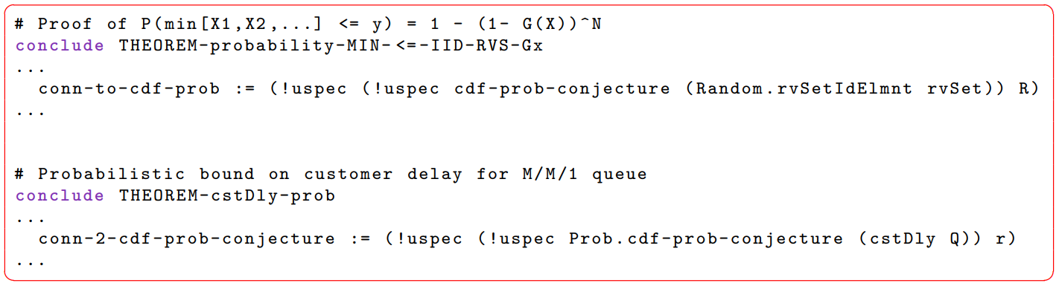
Probabilistic Properties of Distributed Algorithms
A Proof Library in Athena
We have made our Athena formalizations generic and reusable
Can be easily plugged into different contexts during proof development
E.g. - use of the cdf-prob-conjecture, our Athena formalization of the relationship between cdf and probability, in different contexts
Notes:
We have tried to keep our formalizations general and reusable so that common results
Can be simply plugged in to different contexts during proof development
Here we can see an example of the CDF-prob-conjecture,
which expresses the relationship between Cdf and probability,
being plugged into two different proof contexts as required

Slide 47
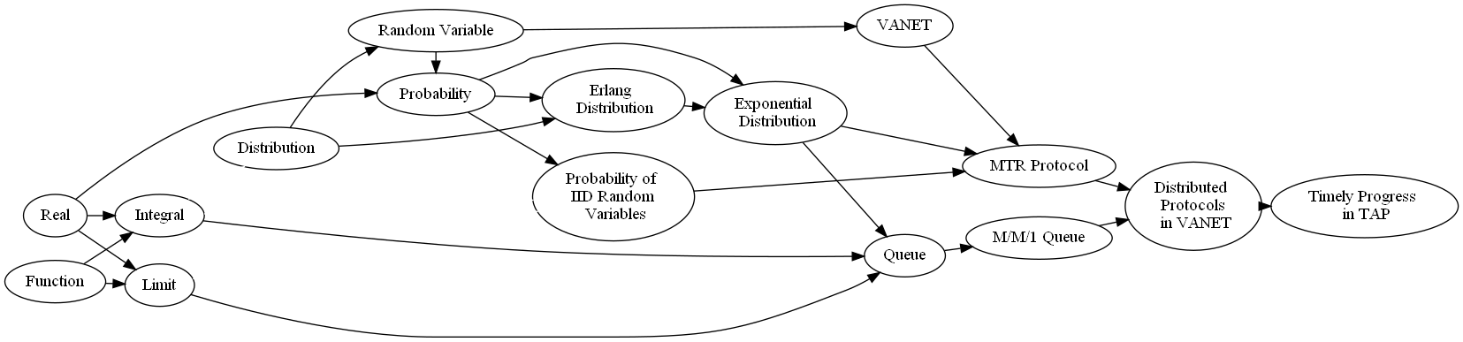
Probabilistic Properties of Distributed Algorithms
A Proof Library in Athena
General Mathematics
Probability Theory
Network Theory
Distributed Algorithms
Hierarchy of modules in version 0.1 of our Athena library
Notes:
This figure shows the hierarchy of version 0.1 of our library
There are four main components
The highest component has some constructs to express concepts from general mathematics
The next component has constructs and proofs form probability theory
The Network theory component has results about queues, and VANETs
And The lowermost component has results about timely progress of distributed algorithms in VANETs

Slide 48
Probabilistic Properties of Distributed Algorithms
Advantages
Probabilistic guarantees of timely progress based on appropriate theories can be useful in the absence of deterministic guarantees
The proof library can be used to mechanically reason about different distributed coordination algorithms deployed over VANETs
Limitations
The probabilistic properties are only useful if the corresponding theoretical assumptions hold at runtime
Notes:
To summarize,
We have presented probabilistic properties that can be useful in the absence of deterministic properties
And a proof library to mechanically reason about such properties of distributed algorithms in VANETs
However, such theoretical properties can only be relevant if the assumptions hold at runtime
Moreover, the current version of our library has some conjectures and does not support algorithms with non-deterministic number
Of messages such as the Synod algorithm

Slide 49
Contents
Introduction
Verification of Decentralized Coordination Algorithms
Eventual Progress in the Synod Consensus Algorithm
A Formally-Verified Knowledge Propagation Algorithm
Verification of Stochastic and Dynamic Distributed Systems
Reasoning about Probabilistic Properties of Distributed Algorithms
Runtime Verification of Dynamic Distributed Algorithms
Conflict-Aware Flight Planning for Multi-Aircraft Coordination
Discussion and Future Work

Slide 50
Runtime Verification of Dynamic Distributed Algorithms
Why Runtime Verification?
Distributed algorithms deployed over VANETs operate in dynamic operating conditions
Theoretical assumptions used for proof-development in the pre-deployment stages may not always hold at runtime
In such situations, need to provide formal guarantees that are relevant at runtime
Challenges
Developing machine-checked formal proofs of complex properties requires considerable amount of skill, time, and human effort
Infeasible to develop such proofs at runtime from scratch
Notes:
As discussed previously,
Properties based on theoretical assumptions may not be relevant at runtime if the assumptions do not hold at runtime
Therefore, in such situations, it is necessary to guarantee properties that are relevant at runtime
However, developing machine-checked proofs of complex properties requires significant manual effort
that cannot be efficiently done at runtime to keep up with the dynamically changing conditions

Slide 51
Runtime Verification of Dynamic Distributed Algorithms
Need to extend the practicality of mathematically rigorous theorem proving techniques beyond the pre-deployment stages
Dynamic Data-Driven Applications Systems [Darema ‘04]
Use a feedback loop to dynamically incorporate new data to enhance a system’s internal model
Allows the development of highly-adaptive systems that can adapt with real-time data
DDDAS-based runtime verification of dynamic distributed applications
Formal progress envelopes
Parameterized proofs
Formal DDDAS feedback loop
Notes:
Therefore, we propose ways to extend the practicality of theorem proving techniques to runtime
Dynamic data driven applications systems is a paradigm that uses feedback loops to dynamically update internal models
of systems, giving way to highly adaptive systems that can adapt with real time data
We use the DDDAS paradigm to propose some techniques for the runtime verification of distributed applications
They are
Progress envelopes
Parameterized proofs
And a formal dddas feedback loop

Slide 52
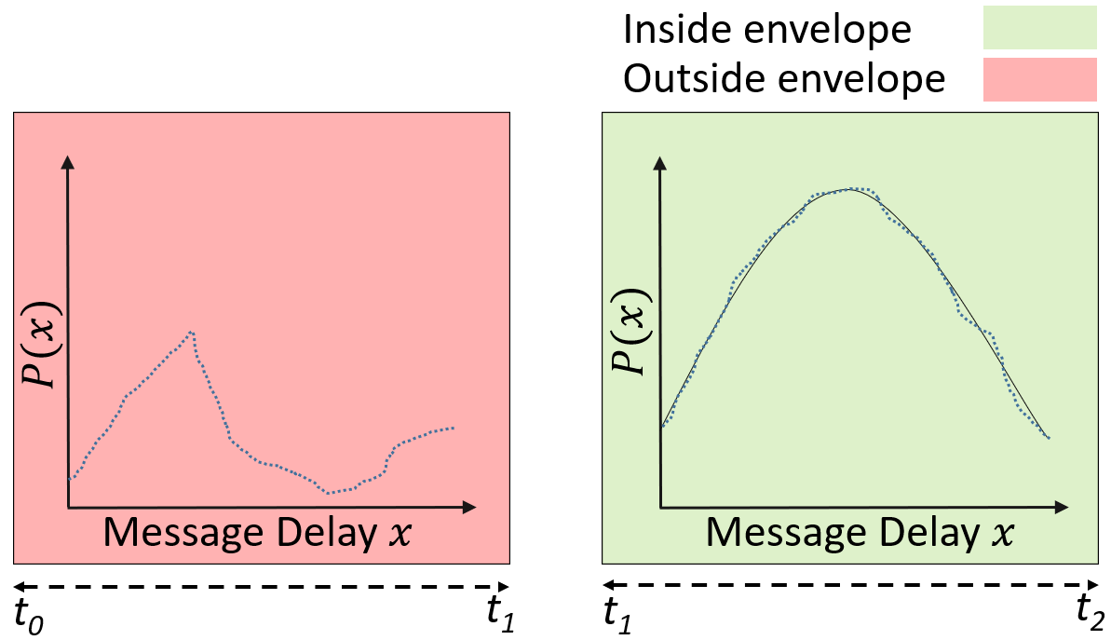
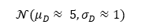
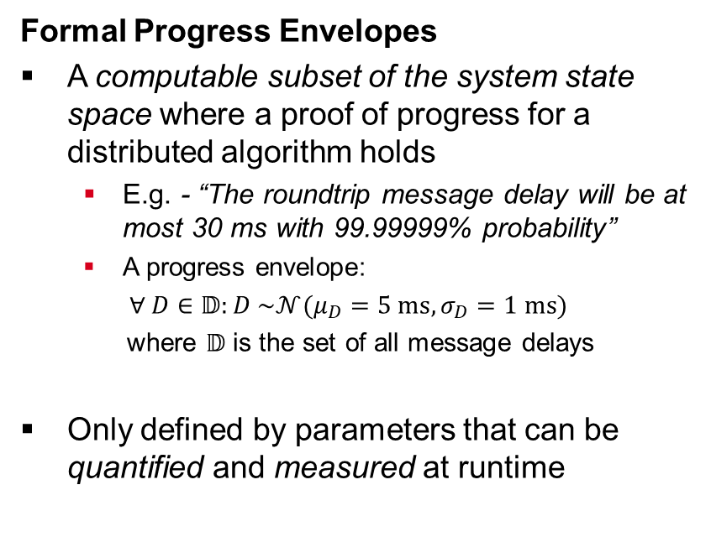
Runtime Verification of Dynamic Distributed Algorithms
Formal Progress Envelopes
A computable subset of the system state space where a proof of progress for a distributed algorithm holds
E.g. - “The roundtrip message delay will be at most 30 ms with 99.99999% probability”
A progress envelope:
$∀ D∈𝔻:D \sim 𝒩(μ_{D}=5 ms, σ_{D}=1 ms)$
where $𝔻$ is the set of all message delays
Only defined by parameters that can be quantified and measured at runtime
$$𝒩(μ_{D}≈ 5, σ_{D}≈1)$$
Notes:
A formal progress envelope is a computable subset of the operational state space where a proof of progress holds
For example, if we have a property that round trip message delay will take at most 30 seconds with probability 99.9999%
which assumes that the delays will be normally distributed with a mean 5 and variance 1
Then at runtime, if we observe that in a period the delays are not normal - then this period will be outside the envelope
Similarly, if in another period, the delays closely follow the assumptions, then this period will be inside the envelope
It must be noted that progress envelopes must only be defined by parameters that can be quantified and measured at runtime

Slide 53
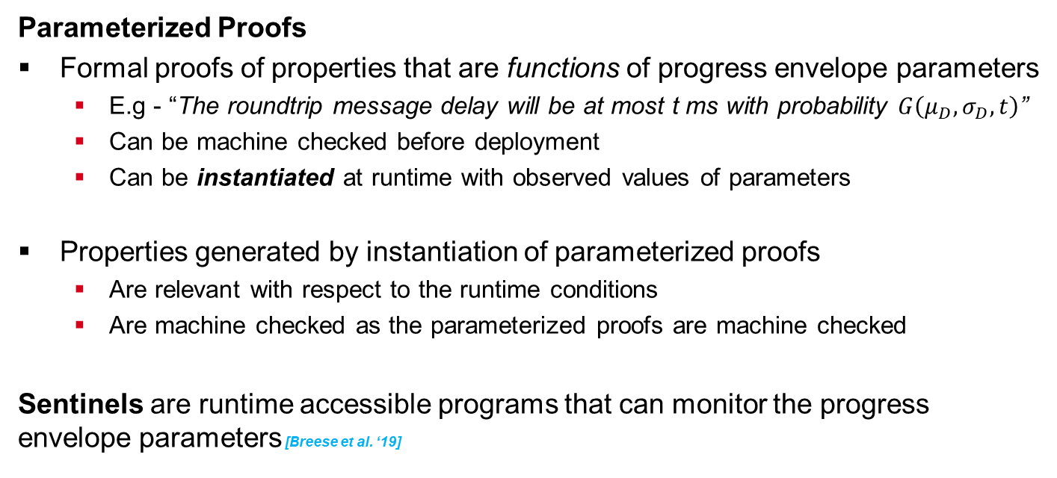
Runtime Verification of Dynamic Distributed Algorithms
Parameterized Proofs
Formal proofs of properties that are functions of progress envelope parameters
E.g - “The roundtrip message delay will be at most t ms with probability $G\left(μ_{D},σ_{D}, t\right)$”
Can be machine checked before deployment
Can be instantiated at runtime with observed values of parameters
Properties generated by instantiation of parameterized proofs
Are relevant with respect to the runtime conditions
Are machine checked as the parameterized proofs are machine checked
Sentinels are runtime accessible programs that can monitor the progress envelope parameters [Breese et al. ‘19]
Notes:
Parameterized proofs are proofs of properties that are functions of progress envelope parameters
For example, we can have a property that states the total message delay in term of a given mean and variance
Such proofs can be machine checked before deployment
and then instantiated at runtime using the observed values of parameters
This allows the generated properties to be relevant and mechanically verified
Sentinels are special runtime accessible programs that can analyze real-life data streams against envelope parameters to detect violations

Slide 54
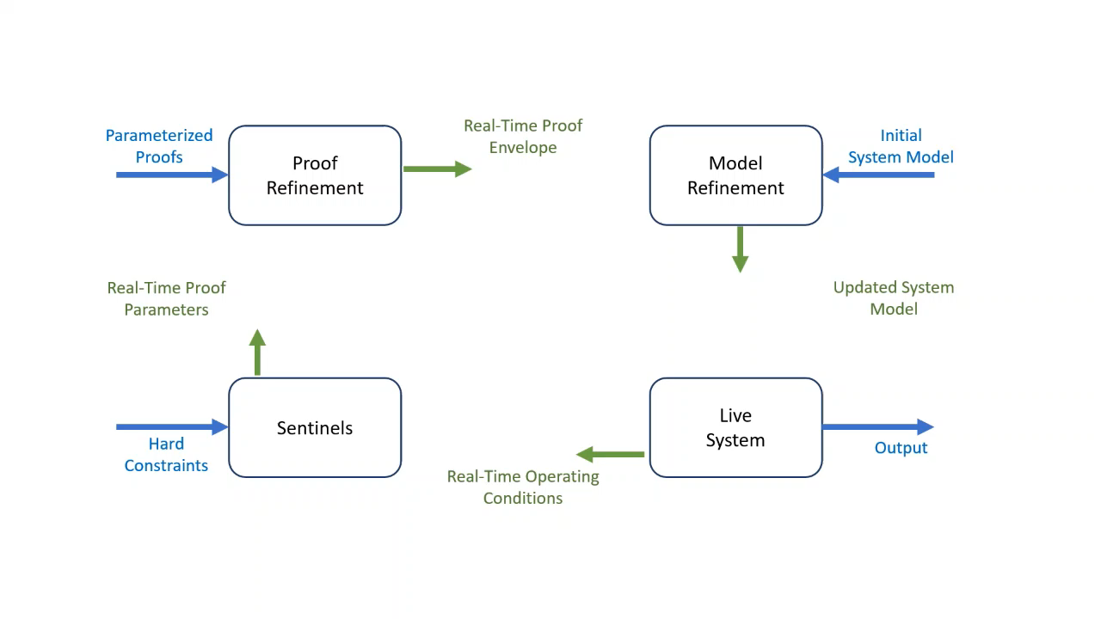
Runtime Verification of Dynamic Distributed Algorithms
Formal DDDAS Feedback Loop
Live system - sends real-time operating conditions to the sentinels
Sentinels - send real-time proof parameters to the proof refinement component
Proof refinement - refines parameterized proofs with new parameters and sends real-time envelopes to the model refinement component
Model refinement - refines the system model and sends it to the live system
Notes:
Using parametrized proofs and formal envelopes, we propose a DDDAS feedback loop
For the runtime verification of dynamic systems
In this approach, there are four components
The live system runs the application and sends real-time parameters to the sentinels
The sentinels analyze the parameters against the latest envelopes and sends informs the proof refinement component if the envelopes are violated
The proof refinement component instantiates parameterized proofs to generate new properties and envelopes which are sent to the model refinement component
The model refinement component can use the knowledge of the latest properties to decide
If the system model must be updated

Slide 55
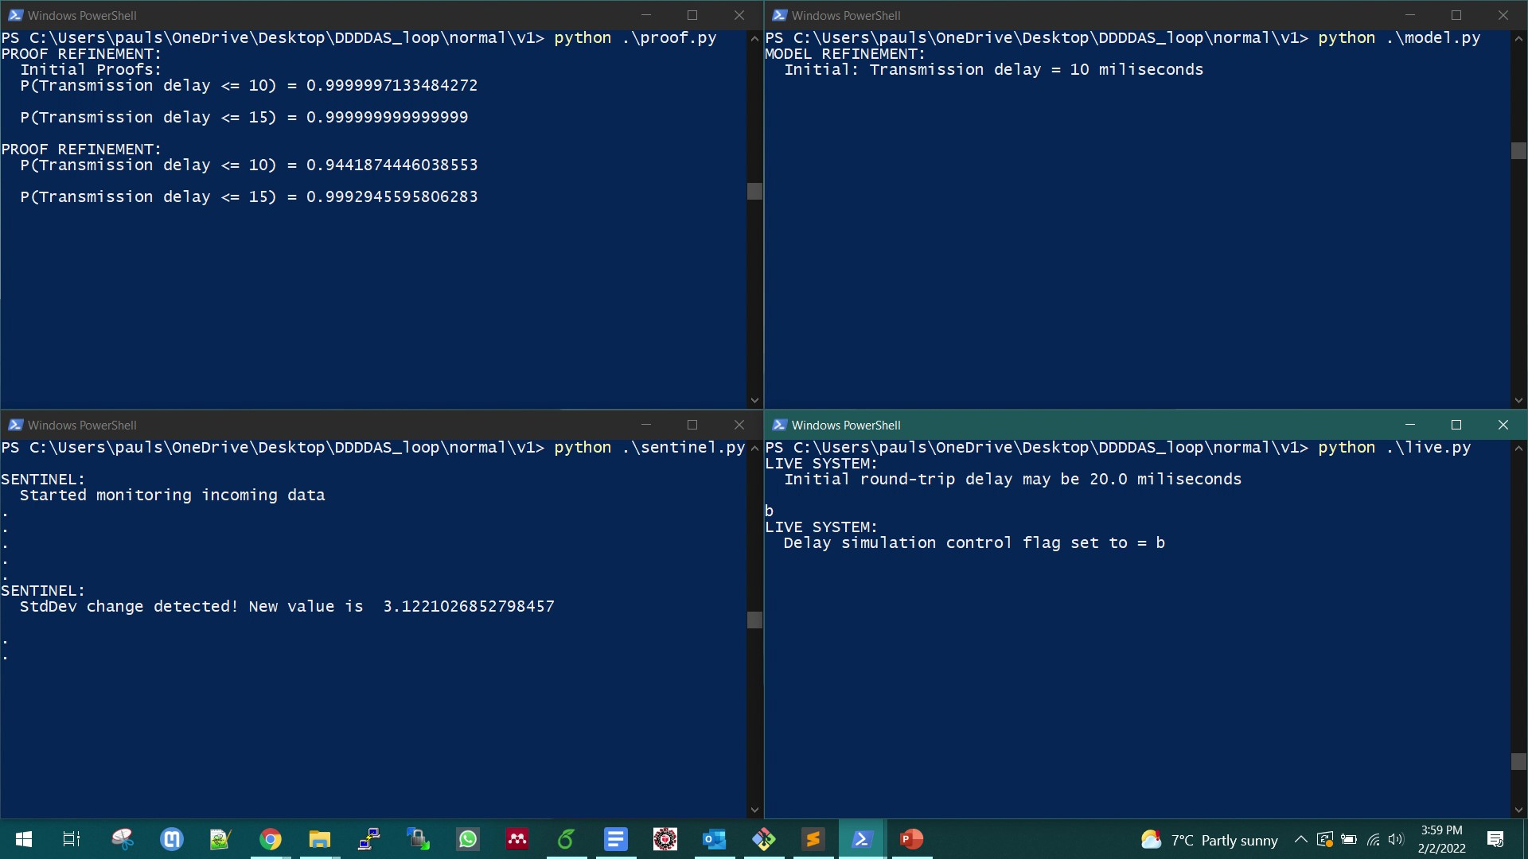
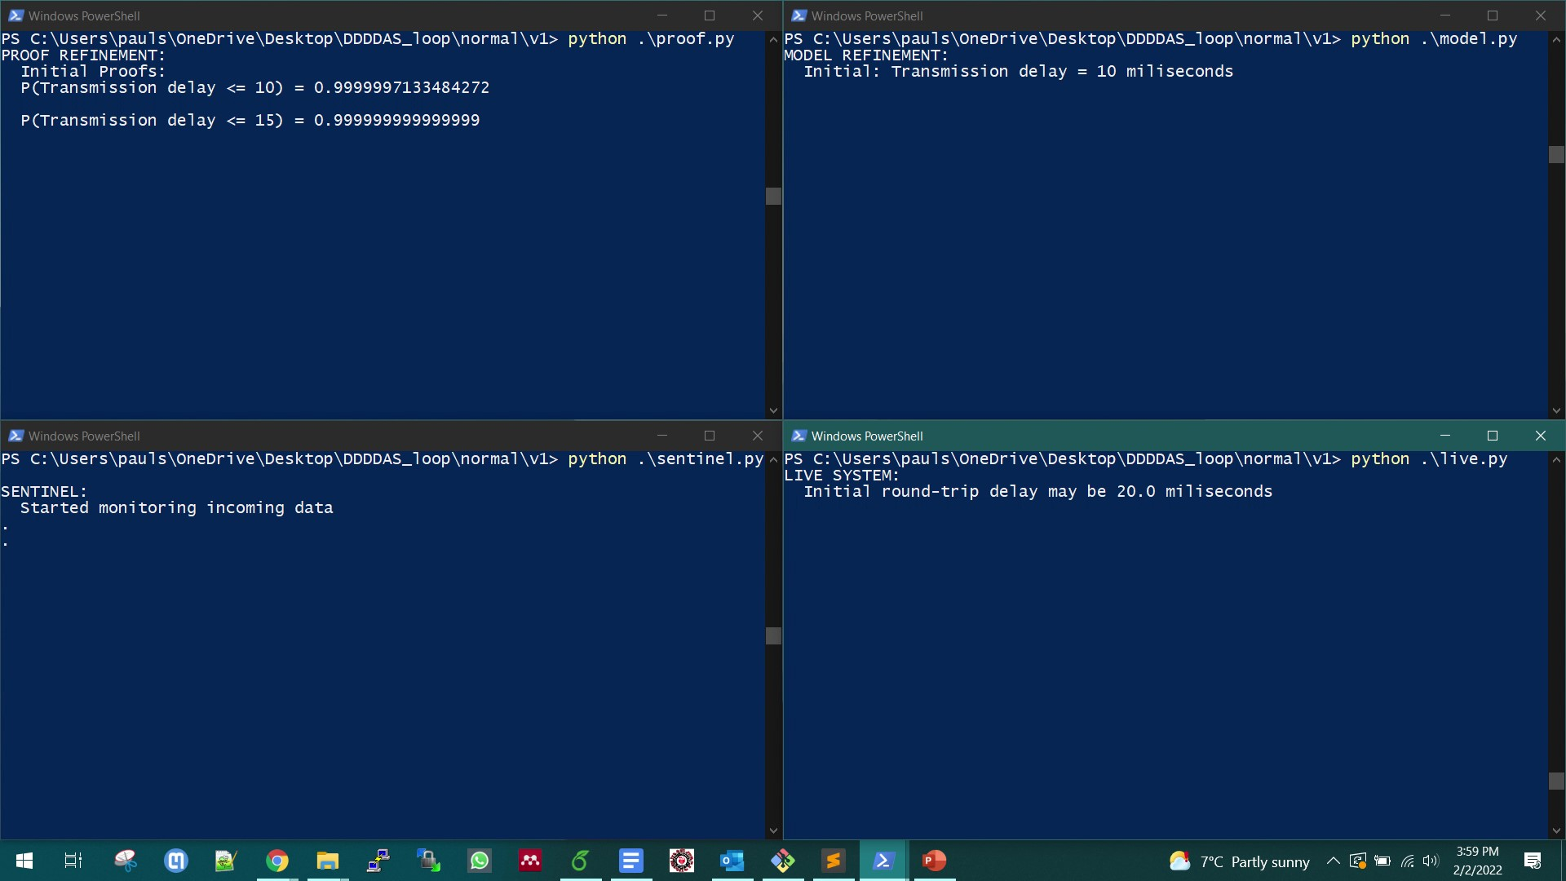
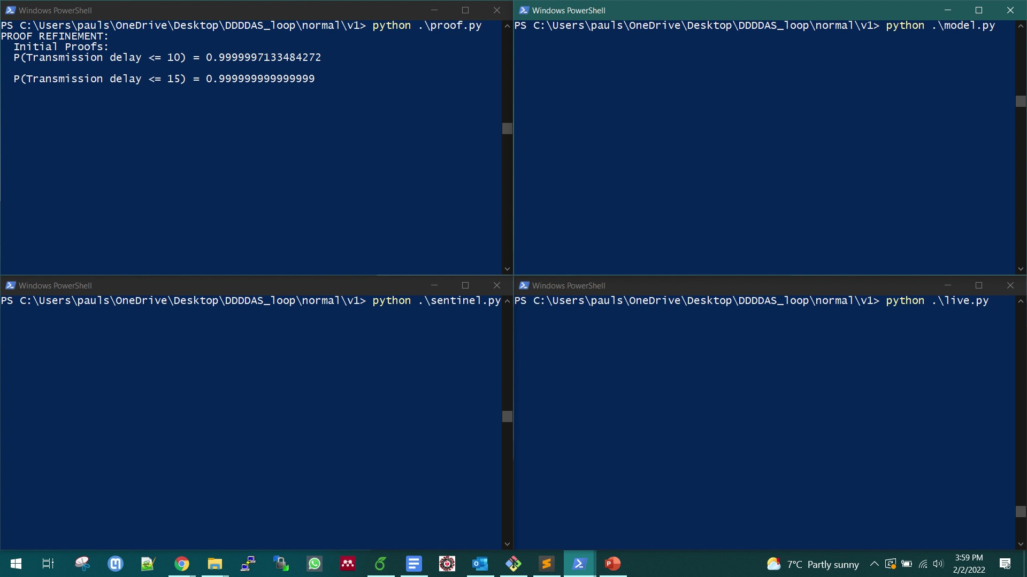
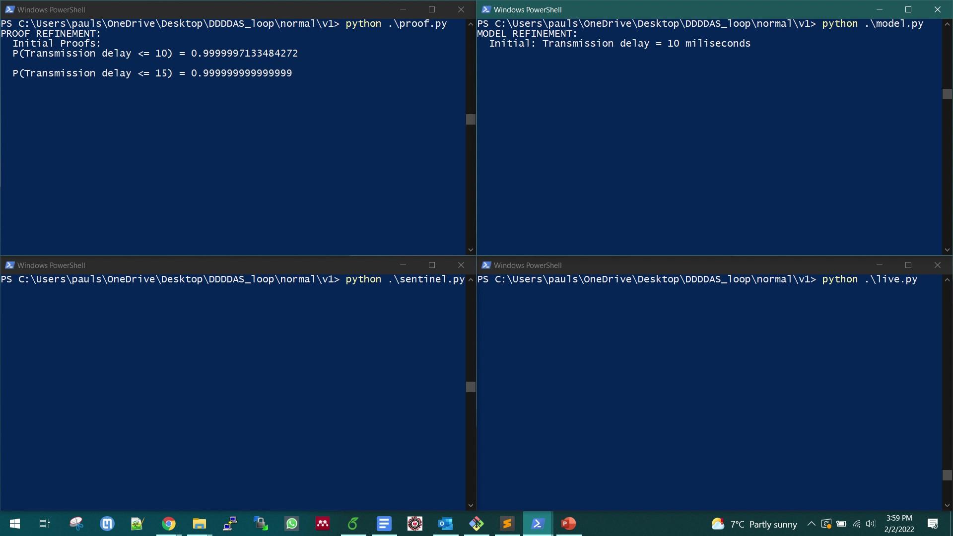
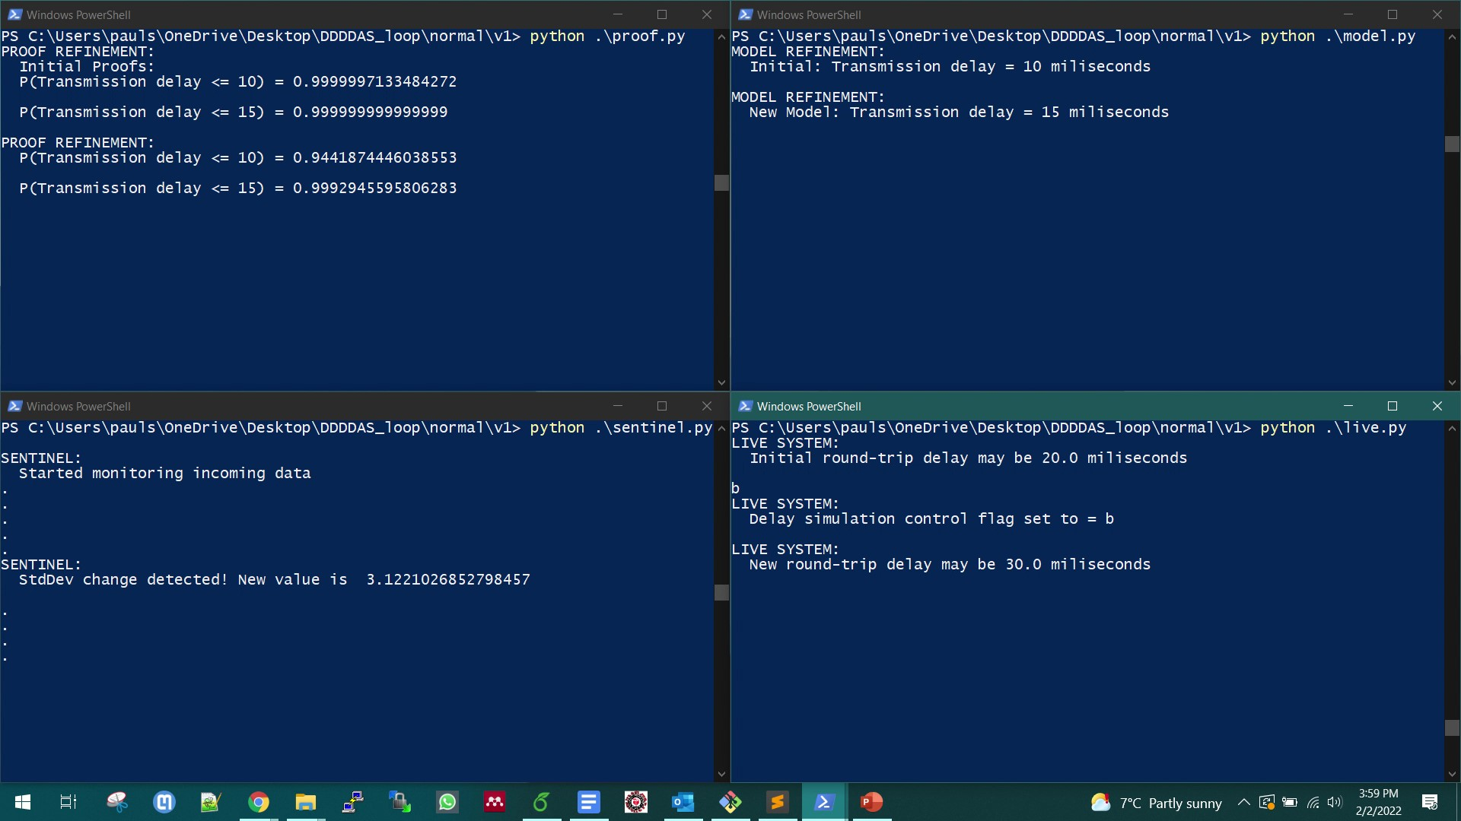
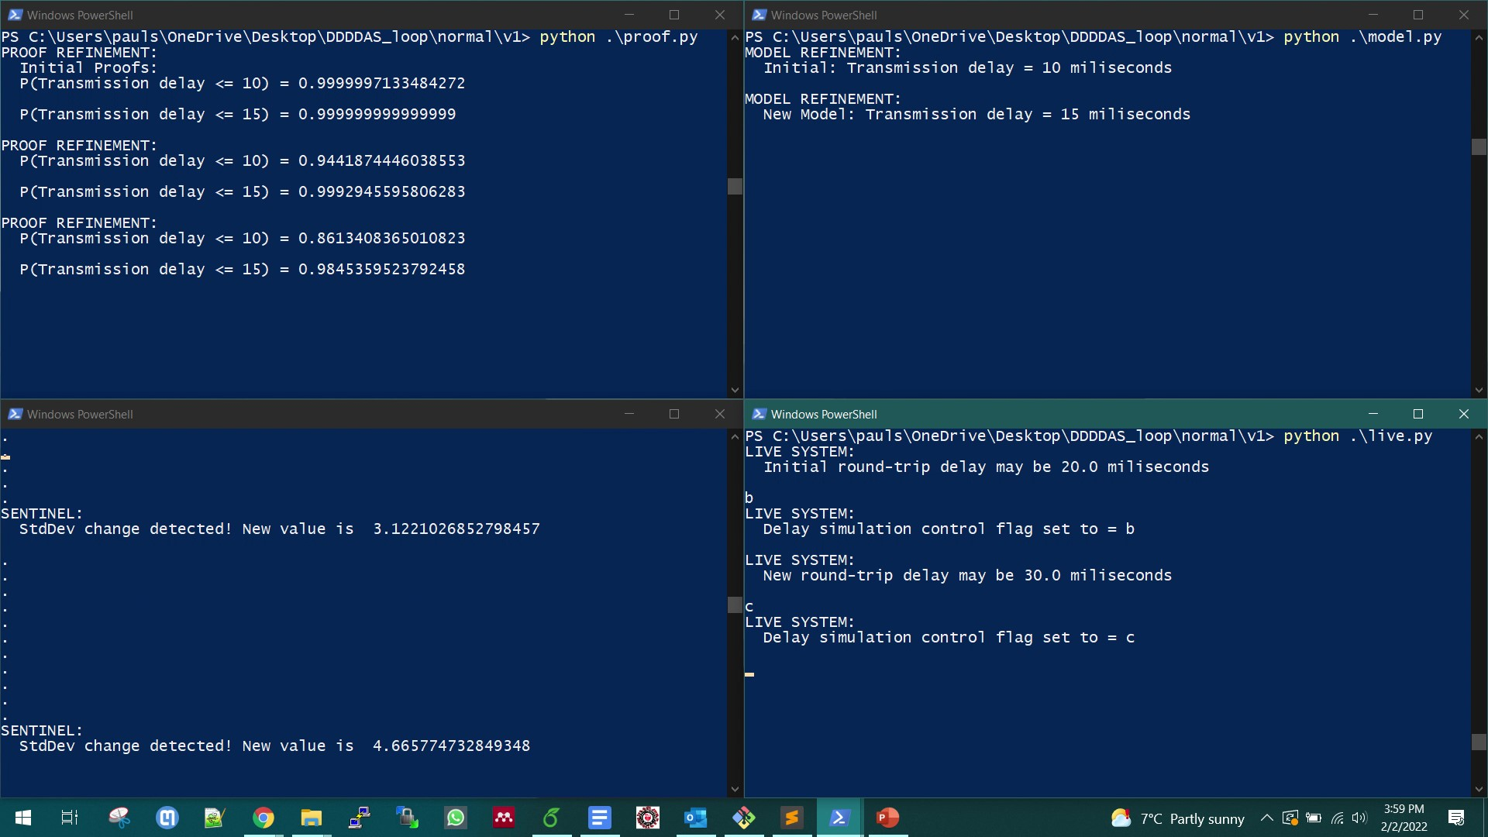
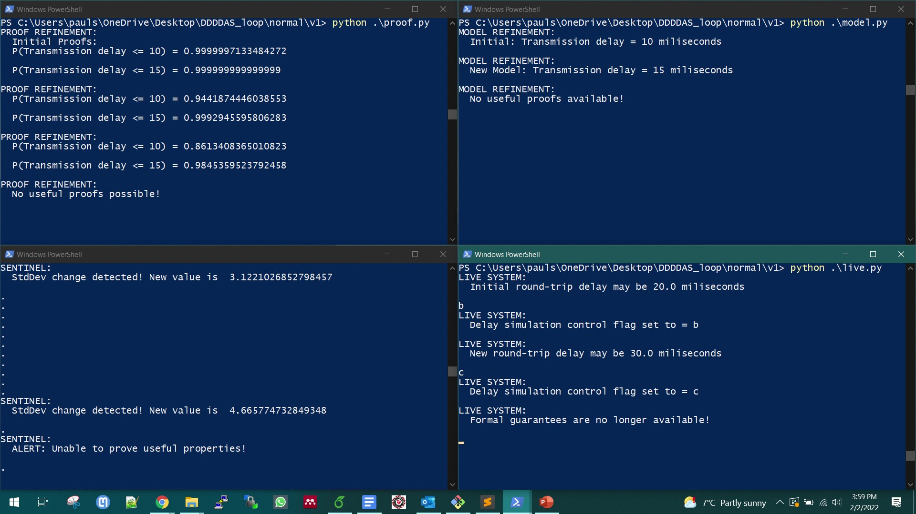
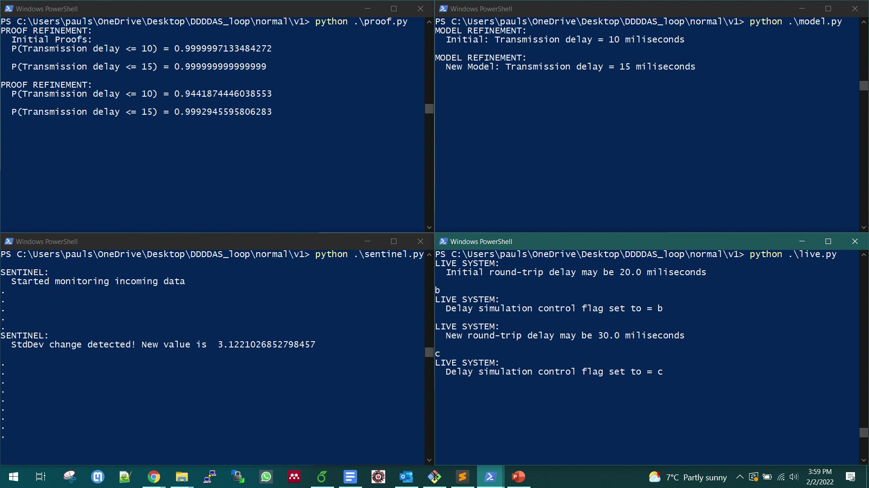
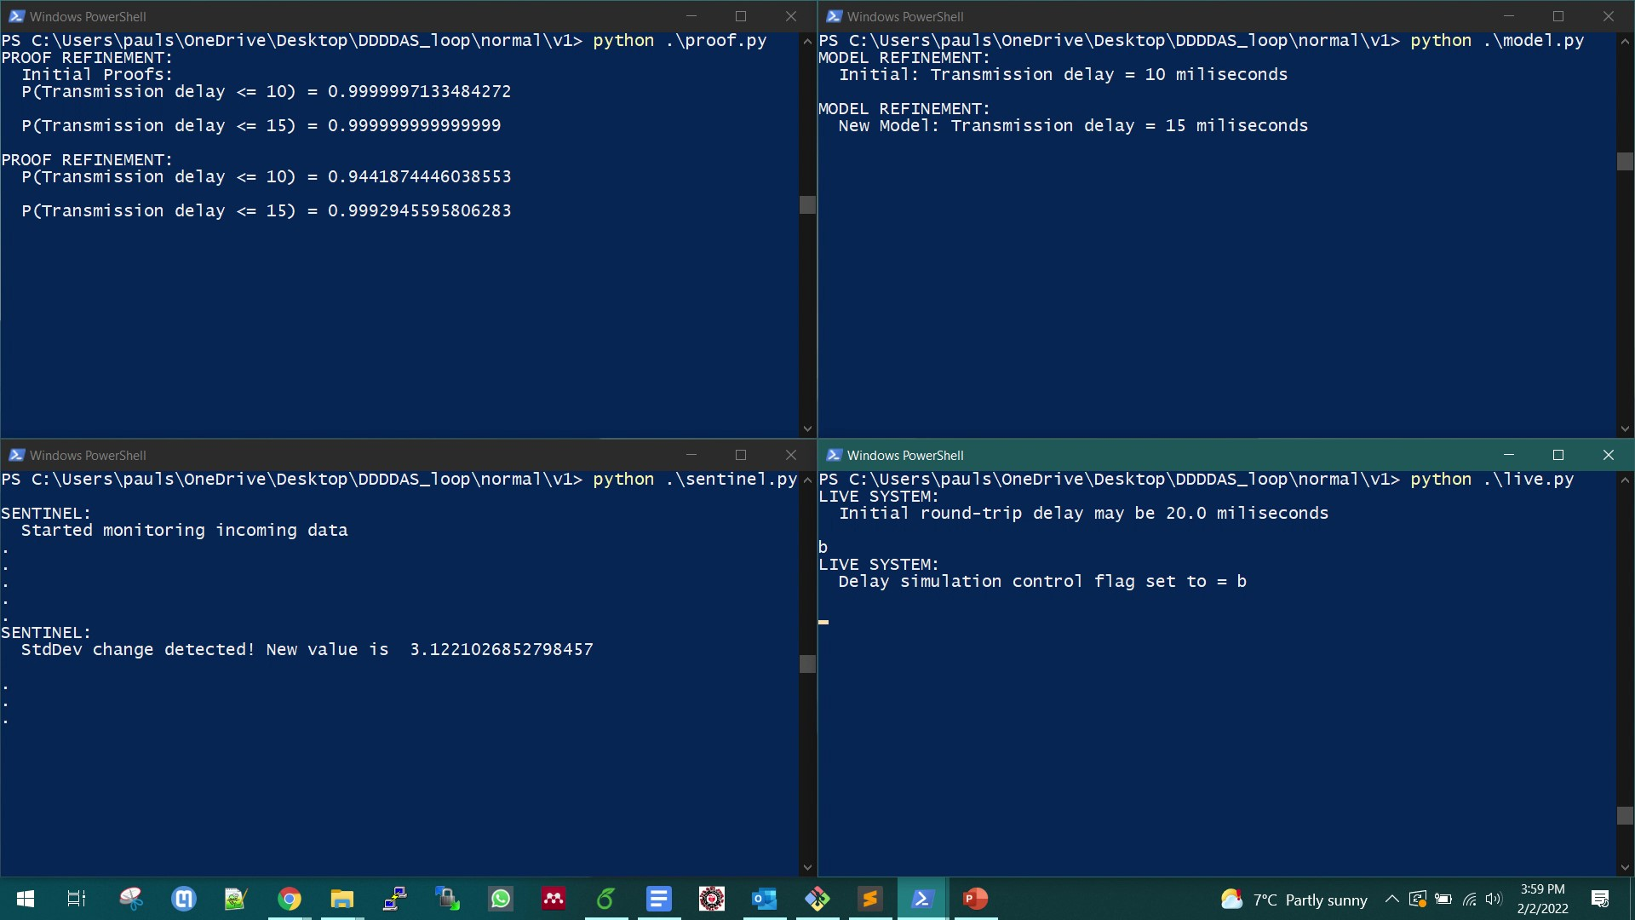
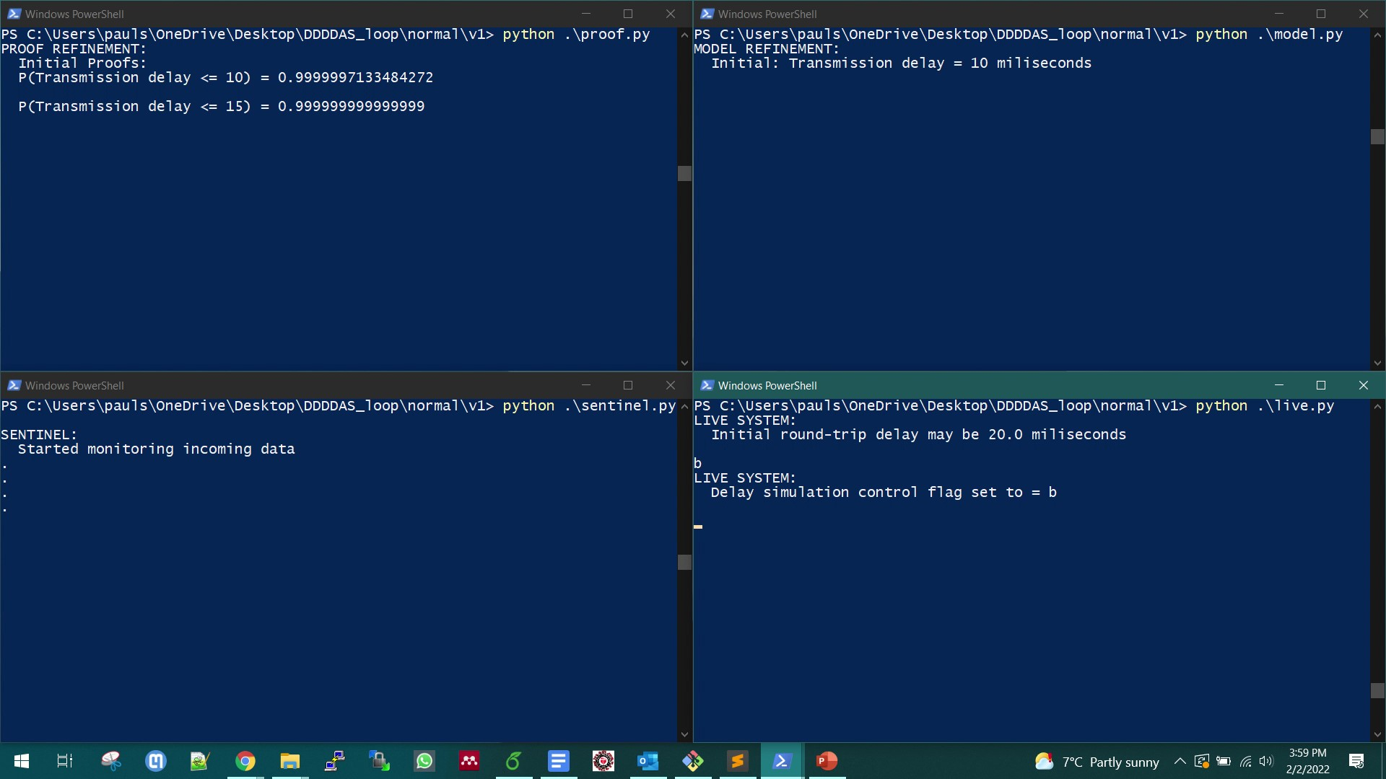
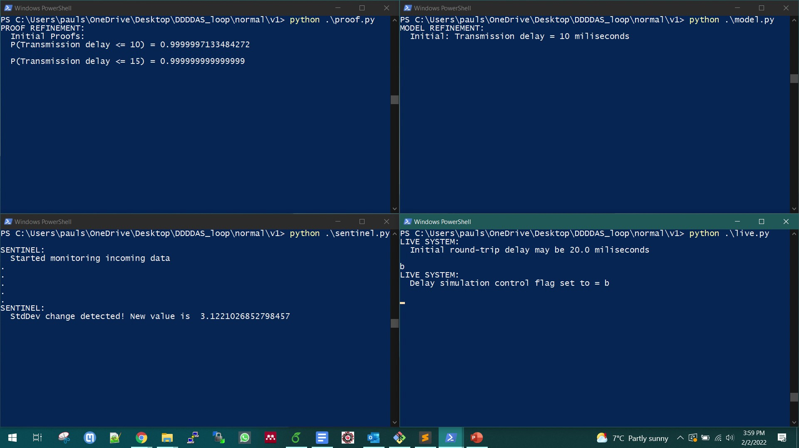
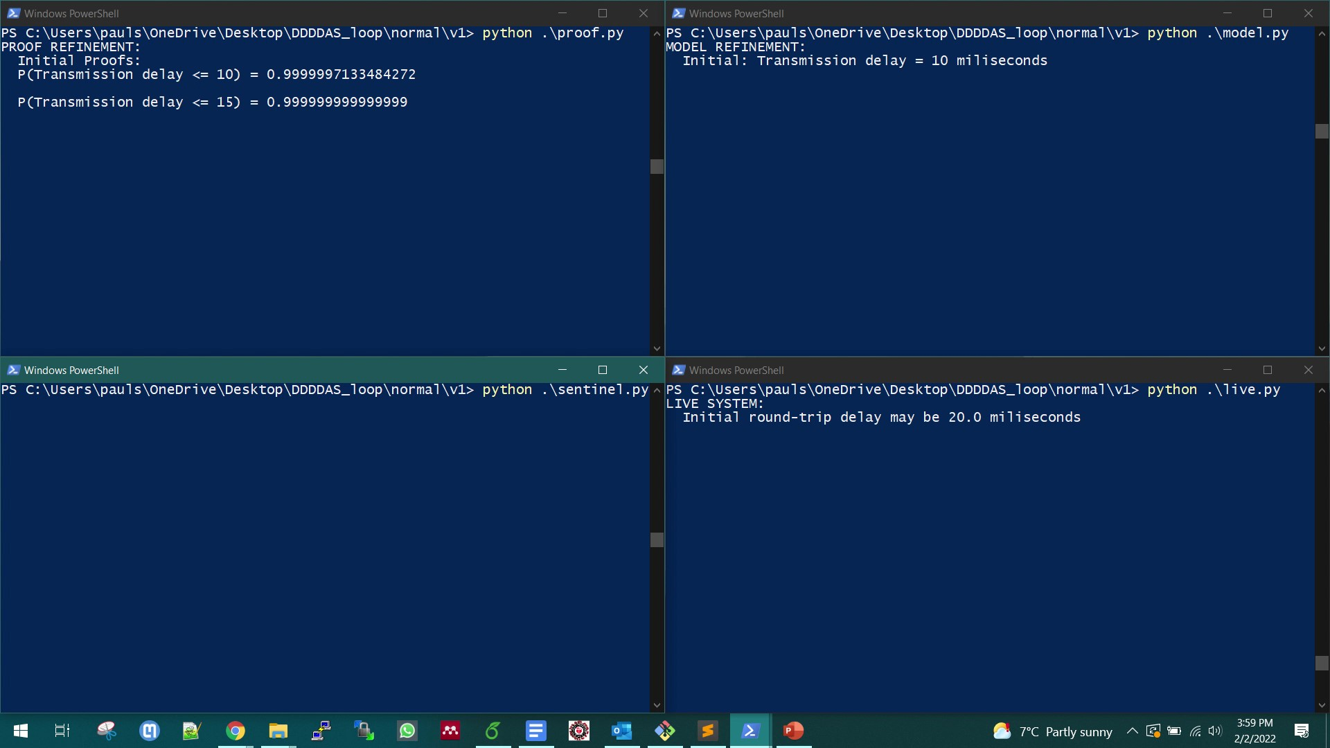
Runtime Verification of Dynamic Distributed Algorithms
Model
Refinement
Proof
Refinement
Sentinel
Live
System
Notes:
We have created a very simple implementation of the formal DDDAS feedback loop

Slide 56
Runtime Verification of Dynamic Distributed Algorithms
Advantages
Can generate formal properties that are relevant at runtime
Extend the usefulness of mathematically rigorous theorem proving techniques beyond the pre-deployment stages
Limitations
Only a limited number of parameterized proofs can be developed and machine-checked before deployment
Notes:
To summarize,
Our techniques allow the development of machine-checked guarantees that are relevant at runtime
and can be used for the runtime verification of dynamic distributed systems
However, it is not highly scalable as it is limited by the number of parameterized proofs that can be developed pre-deployment
If the conditions do not allow instantiation of the pre-developed proofs, no guarantees can be provided
Our approach has also not been experimentally evaluated with respect to real-life systems

Slide 57
Contents
Introduction
Verification of Decentralized Coordination Algorithms
Eventual Progress in the Synod Consensus Algorithm
A Formally-Verified Knowledge Propagation Algorithm
Verification of Stochastic and Dynamic Distributed Systems
Reasoning about Probabilistic Properties of Distributed Algorithms
Runtime Verification of Dynamic Distributed Algorithms
Conflict-Aware Flight Planning for Multi-Aircraft Coordination
Discussion and Future Work

Slide 58


Conflict-Aware Flight Planning for DAC
Candidates must be able to compute conflict-free flight plans with respect to the set of authorized plans $φ$
Detect conflicts with multiple multi-segment flight plans
Resolve those conflicts without creating new ones
Flight plan
A series of waypoints in 4D space
Constant velocity between consecutive waypoints
Notes:
In DAC, candidates must be able to detect and resolve conflicts with the flight plans of the owners
Without creating new conflicts in the process
We define a flight plan as a series of 4d waypoints connected by constant-velocity flight segments

Slide 59




Conflict-Aware Flight Planning for DAC
Conflict/Near Mid-Air Collision (NMAC) [Gifford & Sinha ‘91]
There is a loss of horizontal and vertical separation between two aircraft
Defined as a well-clear volume[Lee et al. ‘13]
Diameter $D$
Height $H$
Well-clear Volumes
$$H$$
NMAC
$$D$$
Notes:
A conflict or a Near Mid Air collision is defined as the simultaneous violation of
Horizontal and vertical thresholds between two airborne aircraft
These thresholds can be visualized as a cylindrical well-clear volume around each aircraft
If the well-clear volumes of two aircraft intersect, they are said to be in an NMAC

Slide 60


Conflict-Aware Flight Planning for DAC
Problem Statement
$φ$ - a set of traffic flight plans not including an Ownship
$D,H$ - horizontal and vertical thresholds
$F$ - original flight plan of the Ownship such that ~safe($φ∪\{F\}$, $D, H$)
$ξ$ - a set of allowed ground speeds for the Ownship
Goal: Find $F^{′}$such that safe($φ∪\{F^{′}\}$, $D, H$)
Strategy
Assign a suitable ground speed to each segment of $F$ to
Avoid any NMAC
Adjust vertical speed to retain the 3D shape of $F$ in $F^{′}$
1
2
3
Notes:
The problem statement for conflict resolution can be stated as
There is a set of authorized traffic flight plans $φ$
There are thresholds D and H
An initial flight plan F for an ownship is given which is not safe with respect to $φ$
A set of allowed ground speeds for the ownship is given
The goal is to compute a plan F’ that is safe with respect to $φ$
Our strategy is to adjust the groundspeed in each segment of the ownships plan to avoid any NMACs
The vertical speed is then adjusted to retain the 3D profile of the original plan

Slide 61


Conflict-Aware Flight Planning for DAC
The assignment of ground speed to the flight segments between waypoints of the Ownship can be arranged as an m x n matrix
m = number of segments
n = number of allowed ground speeds
Initially, all cells are 0 ($M_{0}$)
solve($M, φ,F, D, H$) searches for solutions
Simple recursion-based backtracking algorithm
Returns $M_{0}$ if a suitable assignment matrix cannot be found
Notes:
This assignment of ground speeds can be viewed as a n x m matrix
where n is the number of segments and m is the number of allowed ground speeds
M_0 is the matrix with all 0s
We have developed a solve function that can either return a possible assignment matrix
Or return M_0 otherwise

Slide 62



Conflict-Aware Flight Planning for DAC
Correctness properties
Safety
If solve returns a complete assignment matrix $M$, then adding the flight plan corresponding to $M$ to the set $φ$ produces a safe set of flight plans
Completeness
If solve returns the empty assignment matrix $M_{0}$, then there is no possible assignment matrix $M$ such that adding the flight plan corresponding to $M$ to the set $φ$ would produce a safe set of flight plans
Verified using Athena
Notes:
We have verified two correctness properties of Solve using Athena
Safety states that if solve returns a solution, then the corresponding flight plan will be safe with respect to $φ$
Completeness states that solve will only return M_0 if there is no possible solution

Slide 63
Conflict-Aware Flight Planning for DAC
Advantages
Formally verified strategic approach for conflict detection and resolution
No spatial deviation from the proposed flight plan
Useful in low altitude Standard Terminal Arrival Routes (STAR) and urban environments where there may be no scope for spatial deviation
Limitations
Limited solution space may not always lead to a solution
Only supports a specific type of flight paths
Notes:
To summarize,
Our approach has been formally verified for safety critical uam applications
And since there is no spatial deviation, it can be used in situations where there is no room for spatial maneuvers
However,
The limited solutions space considered may not always lead to solutions
And it only supports a specific type of flight plans

Slide 64
Contents
Introduction
Verification of Decentralized Coordination Algorithms
Eventual Progress in the Synod Consensus Algorithm
A Formally-Verified Knowledge Propagation Algorithm
Verification of Stochastic and Dynamic Distributed Systems
Reasoning about Probabilistic Properties of Distributed Algorithms
Runtime Verification of Dynamic Distributed Algorithms
Conflict-Aware Flight Planning for Multi-Aircraft Coordination
Discussion and Future Work

Slide 65
Discussion
Reasoning about asynchronous communication
Our Failure-Aware Actor Model allows mechanically verifiable reasoning about agent failures
Does not consider Byzantine or adversarial agents, message loss, or arbitrary network partitioning where agents lose communication only with a subset of agents
Reasoning about stochastic distributed algorithms
Probabilistic properties can be useful in the absence of deterministic properties
We have only considered a small subset of possible system conditions
Need to develop theoretical properties under more combinations of conditions
Notes:
Now, I will discuss some observations about our techniques.
We have presented the Failure aware actor model that can be used for reasoning about actor failures,
But FAM does not currently allow modeling other factors such as
Byzantine agents, message loss, or arbitrary network partitioning scenarios
The probabilistic properties we have shown can be useful for aerospace operations,
but we have only considered a small subset of all possible theoretical assumptions
Much work remains to be done on developing properties under other possible assumptions on the conditions

Slide 66


Discussion
Runtime verification using theorem proving techniques
Provides valuable properties when the operating conditions violate theoretical assumptions at runtime
Limited by the number of parameterized proofs that can be pre-developed
Lacks experimental support regarding feasibility in real-world applications
Applications beyond aerospace
Autonomous vehicles
Smart power grids
Industrial robots
Autonomous Cars
Smart Power Grid
Notes:
Finally, Our DDDAS-based approach can allow
The generation of guarantees that are relevant at runtime,
But it has its limitations, and we haven’t performed exhaustive experimental evaluation of the approach
Nevertheless, the techniques we have presented in this talk can be applicable not only
For aerospace systems, but also in domains like
Autonomous vehicles
Smart power grids,
and industrial robots

Slide 67
Future Work
Reasoning about stochastic systems
Proof assistant with first-class support for expressing probabilistic statements and mechanically reasoning about probabilistic properties
Runtime generation and verification of arbitrary properties using Automated Theorem Provers to make the formal DDDAS feedback loop approach more scalable
Verification of distributed algorithms
Formal models to reason about properties in the presence of Byzantine agents, message loss, and arbitrary network partitioning scenarios
Theories to support timely progress for algorithms involving a non-deterministic number of messages
Notes:
Some interesting future directions of work include the investigation of proof assistants
That provide first class support for probabilistic statements and probabilistic deductions
It may also be possible to use DDDAS feedback loop to generate arbitrary properties
At runtime and automatically verify them using automated theorem provers, thereby removing the
Limitations of pre-developed parameterized proofs
Another direction is to investigate formal models like FAM that can be used to reason about
aspects such as message loss, byzantine agents, and arbitrary network partitioning.

Slide 68
Future Work
From theory to practice
Generation of verifiable sentinels from the specifications of properties in our Athena library that can accurately and efficiently measure runtime data
Generation of high-level artifacts for system certification, such as assurance cases, automatically from Athena’s proof environment
Automatically infer compliance to requirements in certification documents like DO-178C (“Software Considerations in Airborne Systems and Equipment Certification”)
Notes:
Finally,
Work needs to be done to ensure that our theoretical techniques can
Be applied for the verification of real life systems
For example, it may be possible to automatically generate verified sentinels
from the specifications in our Athena library
And the generate high-level certification artifacts from proof assistants like Athena
That can be used directly by certifying agencies.

Slide 69




Acknowledgements
Committee members
Dr. Carlos Varela
Dr. Stacy Patterson
Dr. Selmer Bringsjord
Dr. César Muñoz
All my collaborators
Family and friends
Notes:
I would like to end this talk by thanking all my committee members
I would also like to thank all my collaborators, family, and friends
Special thanks to RPI and the department of computer science for providing me with the opportunity
To pursue a doctoral study
I am grateful to the National Science Foundation and the air force for their financial support

Slide 70
References
Agha, G.: Actors: A Model of Concurrent Computation in Distributed Systems. The MIT Press, Cambridge, MA (1986). https://doi.org/10.7551/mitpress/1086.001.0001
Agha, G.A., Mason, I.A., Smith, S.F., Talcott, C.L.: A Foundation for Actor Computation. Journal of Functional Programming 7(1), 1–72 (1997). https://doi.org/10.1017/s095679689700261x
Al Hanbali, A., Kherani, A.A., Nain, P.: Simple Models for the Performance Evaluation of a Class of Two-Hop Relay Protocols. In: International Conference on Research in Networking. pp. 191–202. Springer (2007). https://doi.org/10.1007/978-3-540-72606-7_17
Arkoudas, K., Musser, D.: Fundamental Proof Methods in Computer Science: A Computer-Based Approach. MIT Press, Cambridge, MA (2017). https://doi.org/10.1017/s1471068420000071
Breese, S., Kopsaftopoulos, F., Varela, C.: Towards Proving Runtime Properties of Data-Driven Systems Using Safety Envelopes. In: The 12th International Workshop on Structural Health Monitoring. Stanford, CA (Sep 2019). https://doi.org/10.12783/shm2019/32302
Chaudhuri, K., Doligez, D., Lamport, L., Merz, S.: Verifying Safety Properties with the TLA+ Proof System. In: International Joint Conference on Automated Reasoning. pp. 142–148. Springer (2010). https://doi.org/10.1007/978-3-642-14203-1_12
Darema, F.: Dynamic Data-Driven Application Systems: A New Paradigm for Application Simulations and Measurements. In: Computational Science-ICCS 2004. pp. 662–669. Springer (2004). https://doi.org/0.1007/978-3-540-24688-6_86
Fagin, R., Halpern, J.Y., Moses, Y., Vardi, M.: Reasoning About Knowledge. MIT press (2004). https://doi.org/10.7551/mitpress/5803.001.0001
Fischer, M.J., Lynch, N.A., Paterson, M.S.: Impossibility of Distributed Consensus With One Faulty Process. Journal of the ACM (JACM) 32(2), 374–382 (1985). https://doi.org/10.1145/588058.588060
Gifford, J.L., Sinha, P.: Airport Congestion and Near-Midair Collisions. Transportation Research Part A: General 25(2), 91–99 (1991). https://doi.org/10.1016/0191-2607(91)90128-D

Slide 71
References
Hewitt, C.: Viewing Control Structures as Patterns of Passing Messages. Artificial Intelligence 8(3), 323–364 (1977). https://doi.org/10.1016/0004-3702(77)90033-9
Lamport, L.: Paxos Made Simple. ACM SIGACT News 32(4), 18–25 (2001)
Lamport, L.: The Part-Time Parliament. ACM Transactions on Computer Systems (TOCS) 16(2), 133–169 (1998). https://doi.org/10.1145/279227.279229
Lee, S.M., Park, C., Johnson, M.A., Mueller, E.R.: Investigating Effects of Well Clear Definitions on UAS Sense-And-Avoid Operations in Enroute and Transition Airspace. In: Aviation Technology, Integration, and Operations Conference. p. 4308 (2013). https://doi.org/10.2514/6.2013-4308
Lipsky, L.: M/M/1 Queue. Queueing Theory: A Linear Algebraic Approach pp. 33–75 (2009). https://doi.org/10.1007/978-0-387-49706-8_2, https://doi.org/10.1007/978-0-387-49706-8_2
Queille, J.P., Sifakis, J.: Fairness and Related Properties in Transition Systems — A Temporal Logic to Deal with Fairness. Acta Informatica 19(3), 195–220 (1983). https://doi.org/10.1007/bf00265555
Varela, C.A.: Programming Distributed Computing Systems. The MIT Press, Cambridge, MA (2013)

Slide 72
My Publications
S. Paul, G. A. Agha, S. Patterson, and C. A. Varela. “Eventual Consensus in Synod: Verification Using a Failure Aware Actor Model", Innovations in Systems and Software Engineering: A NASA Journal (Invited paper, under review).
S. Paul, E. Cruz-Camacho, A. Bhaumik, A. Dutta, E. Blasch, G. A. Agha, F. Kopsaftopoulos, S. Patterson, and C. A. Varela, “Formal Verification of Safety-Critical Aerospace Systems”, IEEE Aerospace & Electronic Systems Magazine, (Submitted, under review)
S. Paul, S. Patterson, and C. A. Varela. “Formal Guarantees of Timely Progress for Distributed Knowledge Propagation", 3rd Workshop on Formal Methods for Autonomous Systems, Oct. 2021.
V. T. Valapil, H. Herenzia-Zapana, M.Durling, K. Armstrong, S. Paul, S. Borgyos, A. Moitra, and W. Premerlani. “Towards Formalization of a Data Model for Operational Risk Assessment", 40th AIAA/IEEE Digital Avionics Systems Conference, Oct. 2021.
B. Meng, S. Paul, A. Moitra, K. Siu, and M. Durling. “Automating the Assembly of Security Assurance Case Fragments", 40th International Conference on Computer Safety, Reliability, and Security, Sep. 2021.
S. Paul, G. A. Agha, S. Patterson, and C. A. Varela. “Verification of Eventual Consensus in Synod Using a Failure Aware Actor Model", 13th NASA Formal Methods Symposium, May 2021.
S. Paul and C. A. Varela. “Data-Driven Wind-Aware Emergency Trajectory Generation", Journal of Aircraft, Accepted May 2021. (To appear)
B. Meng, D. Larraz, K. Siu, A. Moitra, J. Interrante, W. Smith, S. Paul, D. Prince, H. Herencia-Zapana, M. F. Arif, M. Yahyazadeh, V. T. Valapil, M. Durling, C. Tinelli, and O. Chowdhury. “VERDICT: A Language and Framework for Engineering Cyber-Resilient and Safe System", Systems, Mar. 2021.
S. Paul, S. Patterson, F. Kopsaftopoulos, and C. A. Varela. “Towards Formal Correctness Envelopes for Dynamic Data-Driven Aerospace Systems", Handbook of Dynamic Data-Driven Applications Systems, Accepted Nov. 2020. (To appear)
S. Paul, S. Patterson, and C. A. Varela. “Collaborative Situational Awareness for Conflict-Aware Flight Planning", 39th AIAA/IEEE Digital Avionics Systems Conference, Oct. 2020.

Slide 73
My Publications
S. Paul, F. Kopsaftopoulos, S. Patterson, and C. A. Varela. “Dynamic Data-Driven Formal Progress Envelopes for Distributed Algorithms", InfoSymbiotics/DDDAS2020, Oct. 2020.
E. Cruz-Camacho, S. Paul, F. Kopsaftopoulos, and C. A. Varela. “Towards Provably Correct Probabilistic Flight Systems", InfoSymbiotics/DDDAS2020, Oct. 2020.
B. Meng, A. Moitra, A. W. Crapo, S. Paul, K. Siu, M. Durling, D. Prince, H. Herencia-Zapana. “Towards Developing Formalized Assurance Cases", 39th AIAA/IEEE Digital Avionics Systems Conference, Oct. 2020.
S. Paul, S. Patterson, and C. A. Varela. “Conflict-Aware Flight Planning for Avoiding Near Mid-Air Collisions", 38th AIAA/IEEE Digital Avionics Systems Conference, San Diego, CA, USA, Sep. 2019.
S. Paul, “Emergency Trajectory Planning for Fixed-Wing Aircraft", Master’s Thesis, Rensselaer Polytechnic Institute, Troy, NY, Dec. 2018.
S. Paul, F. Hole, A. Zytek, and C. A. Varela. “Wind-Aware Trajectory Planning for Fixed-Wing Aircraft in Loss of Thrust Emergencies", 37th AIAA/IEEE Digital Avionics Systems Conference, London, UK, Sep. 2018.
S. Paul, F. Hole, A. Zytek, and C. A. Varela. “Flight Trajectory Planning for Fixed-Wing Aircraft in Loss of Thrust Emergencies", InfoSymbiotics/DDDAS2017, Cambridge, MA, Aug. 2017.

Slide 74
Thank You!

Slide 75
Extra Slides

Slide 76

Why Athena
Familiarity
We already had some work on conflict-aware flight planning and eventual progress in Synod that we wanted to combine together for ATM
Athena’s constructs such as the chain tactic make it easy to write mathematical proofs that are readable with respect to their informal counterparts

Slide 77
Why Athena
Athena can be used to generate implementable code - a computational language
Can generate sentinels from the specifications of parameterized properties
We took a top-down approach where we developed the high-level properties of interest and then developed the lower-level proofs
Goal was to show how high-level probabilistic properties of timely progress for distributed algorithms can be developed
We formalized theories as we needed them
Tailored for our needs
It was much easier to express required properties using constructs that are designed in-house
Available libraries in Isabelle, Coq, PVS would require us to take a bottom-up approach
Not tailored for our needs
May deviate from our goal

Slide 78
Why FAM?
We wanted to consider scenarios where aircraft can have communication failures
Causing messages to get lost would have changed the fairness guarantees of the actor model
Fairness is very useful for reasoning about progress
We wanted to start with a simple failure model without sacrificing fairness and check the theoretical boundaries for mechanically proving progress under that model
Other variations like Transactors[Field and Varela, 2005] can model message loss

Slide 79
What I Would Particularly Like to Work On
A verified end-to-end system for autonomous ATM that considers
How to divide the airspaces?
How to handle multiple airspaces?
Use hierarchical coordination protocols?
How to handle emergency and non-cooperative aircraft?
How to consider business goals of operators in safety-critical decision making?
How safe is a plan that reaches in time to retain runway slot?
Verifying correctness with respect to the requirements of standards like DO-178C
Create a framework so that theorem proving techniques can be used more practically for the verification of complex aerospace systems
A rich parameterized proof library
A verified platform to execute the runtime verification feedback loop

Slide 80
My Vision
Usage
Real-life operating conditions are impossible to model with certainty, so it may not be possible to provide guarantees under all circumstances
Beyond some threshold, it will become impossible to guarantee anything useful
Autonomous aircraft will be able to communicate with other aircraft, collect data at runtime, and generate local correctness guarantees to help in their own decision-making process
Probabilistic guarantees are never going to be accurate, but they can be more useful for decision making than having no guarantees at all
Ultimately, it is the responsibility of the operators of the autonomous aircraft to decide how they should use these guarantees for decision-making
Should a plan be executed if there is only 95% probability of success?
The operators would encode the decision-making procedures while designing the autonomous logic and would be responsible in case anything goes wrong
E.g. - Recently, Tesla engineers consciously introduced a feature that allowed the cars to illegally roll through all-way stops if their radars detected no cars in the vicinity

Slide 81
My Vision
Verification
Specifications of the algorithms will be developed in proof assistants
Mechanically verified for to satisfy some correctness requirements
Implementations of the algorithms will be generated automatically from the verified specifications
Sanity check - The implementations can be model checked to ensure compliance
Assurance cases can be generated to connect the results of mechanical verification and model checking with the requirements in certification documents
Can be used to certify the final implementations
At runtime, guarantees about the system conditions can be generated that can be used by the autonomous aircraft to make important operational decisions
The decision-making logic must also be verified and certified pre-deployment

Slide 82
Application in Practical Systems
Theoretically, the concepts are applicable to real-life vehicular systems
To be in a position where we can see this being practically used
The proof library must be expanded
Must be able to generate verified sentinels
Verified interfacing to represent the formal results as high-level artifacts for easy comprehension
Actual implementations of the verified software must be created
Experimental simulations to determine the feasibility of the assumptions and improve them

Slide 83
Probabilistic Properties
Reusable Constructs
Non-Reusable
Not general to be used in different contexts
Probability that the random variable X will take a value <= y
(probability-RandVar<=c X y)
Probability that the random variable X will take a value > y
(probability-RandVar>c X y)
Reusable
General enough to be used in different contexts
Probability that the random variable X will take a value <= y
(probE (consE <= X y))
Probability that the random variable X will take a value > y
(probE (consE > X y))

Slide 84
Probabilistic Properties
Reusable Constructs
For reusability
Need to understand how the same theory can be used in different contexts
Requires having multiple contexts to try out the expressing power of the constructs
I have taken a trial-and-error approach
Generality increases expression power
Probability that two random variables take at most two given real values
(probE (cons2E (consE <= X1 y1) (consE <= X2 y2) ) )
The first example would not have allowed this

Slide 85
Probabilistic Properties
Reasoning About Reals
Real numbers are approximated using a finite number of bits
Floating-point representation
Can cause issues in computations - e.g., round-off errors
Formal analysis of floating-point computations is an independent research area
Out of the scope of this research
Real numbers are used as a theoretical domain in our work
We simply assume that the functions performing real operations will theoretically satisfy expected mathematical properties
E.g., (sum (sum a b) c) = (sum a (sum b c))

Slide 86
Model Checking vs Theorem Proving
Model Checking
An abstract model of a system is created and tested against a finite set of inputs to check if required correctness properties hold
Can automatically check for complex properties
Has to exhaustively search finite state spaces
Limited to small models
Suffers from “state space explosion” where increase in the number of states causes the state space to grow exponentially
Theorem Proving
A formal specification of a system is created as a set of logical statements and then logical inference rules are used to prove that the specification entails the correctness properties
Proofs of complex properties usually require significant manual effort and expertise
Can reason about infinite system states without added overhead

Slide 87
Automated Theorem Proving
Can automatically search for proofs of properties from supplied contexts
Suitable for simple properties
May not always be able to find a proof even if one exists
Easy to send inconsistent context to the prover and derive a proof of any statement
In my experience
The proofs cannot be obtained as a set of logical inference rules - used as black boxes
In case the sentences are complex, the ATPs may not be able to find solutions and time out
Even if the proof is a simple one step modus ponens

Slide 88
AI/ML and Formal Methods
Machine checked formal proofs are based on logical specifications of analytical properties of systems
Machine learning models are data-driven
Weights are selected based on the training data and heuristics - e.g., a Perceptron
Do not have perfect analytical representations
Can we analytically prove why perceptron A works better than perceptron B?
The behavior cannot be logically specified as a set of axioms
The same model can behave differently with different datasets
Complexity of techniques such as neural networks
Very difficult to specify and verify
May be possible to verify individual components
Machine learning models are usually not 100% accurate
Deterministic properties may not be possible
May be possible to guarantee probabilistic properties

Slide 89
AI/ML and Formal Methods
Existing work
Use of SMT solvers to model check neural networks
Use of Mixed Integer Linear Programming (MILP)
Use of abstract interpretation to reason about properties

Slide 90
ATHENA vs TLAPS
Athena is more intuitive for me to express mathematical theory than TLAPS
TLAPS lacks the ability to define domains/data types and define functions/operators over those domains
Athena’s prevents writing ill-sorted terms. This cannot be done in TLAPS and causes added overhead because separate type-checking has to be added to the specifications and then verified
Athena’s built-in tactics such as equality chaining can be very intuitive for writing mathematical proofs
Modules make it easy to organize the theories in Athena meaningfully

Slide 91
ATHENA vs TLAPS
The implicit intuition in TLAPS is to use backend ATPs to develop complex hierarchical proofs
Can lead to errors because of inconsistency
If needed, this can be replicated in Athena upto some degree
TLAPS provides a nice interface

Slide 92
Proving Progress vs Safety
Safety properties can usually be encoded as invariants that remain true before and after every possible action in an algorithm
Are not affected by unpredictable factors such as message delays or agent failures
If nothing happens at all, then nothing bad happens, so safety is satisfied trivially
Progress properties require reasoning about all valid computation paths and showing that some desirable state will be eventually attained in all valid paths
Are affected by unpredictable factors such as message delays or agent failures
Additional assumptions such as fairness required

Slide 93
Decentralized Admission Control
4D airspace
Combination a fixed 3D airspace and a time period
Proper ways to discretize needs further research
Airspace to airspace transfers
The aircraft may need to get permission from owners of each airspace they will use
Owners of each airspace will agree on the part of the flight plan through that airspace only
An aircraft can only execute a flight plan if it has been approved for all transit airspaces
Bootstrapping DAC
There can be a simple edge device for each 3D airspace to bootstrap or act as coordinator whenever possible
After that, if the edge device fails, then DAC can take over

Slide 94

Runtime Verification of Dynamic Distributed Algorithms
Formal DDDAS Feedback Loop
Not possible to have global view of system conditions in distributed settings
The guarantees are based on local views that are reflected in the live system in each agent
Transmission delay between ownship and another connected aircraft
May not be possible to get global guarantees
Round-trip delays delays between random pairs of aircraft

Slide 95
Byzantine and Adversarial Agents
Byzantine agents
Agents that can exhibit arbitrary faulty behavior
E.g.- An acceptor in Synod that sometimes fails to respond with “promise” messages even if it should
E.g. - An acceptor that sometimes does not respond to a particular proposer’s messages
E.g. - An agent that sends incomplete messages because of some bug in its code
Adversarial agents
Agents that are designed to cause some application to fail
E.g. - A proposer that always tries to interrupt other proposers just to affect progress

Slide 96
Relation of Our Work to SMT
We can use SMT solvers to encode the conflict-detection problem
If the solver cannot find a solution, then two paths may be conflict free
If a conflict exists, the SMT solver may return the parameters (usually the time)
The matrix assignment problem can be encoded as an SMT problem
If a solution assignment matrix exists, then the SMT solver returns the parameters
If a solution matrix does not exist, the solver can return unsat
SMT solvers like Z3 are also used as backend ATPs in TLAPS and as the basis of model checkers like Kind2

Slide 97
Relation of Our Work to Model Checking
Model checking can be used in conjunction to theorem proving for developing correct specifications
Before trying to prove a property using theorem proving, model checking can be used to check if the property actually holds given the specification
Since SMT-based model checkers can find counter examples, it may also be possible to use this for conflict detection

Slide 98
Relation of Our Work to Automated Reasoning
ATPs can be used to prove simple proof obligations during proof development
We have used SPASS with Athena for the eventual progress property in Synod
TLAPS intrinsically uses Isabell, Z3, etc
Need to be careful as it is easy to make a mistake and send inconsistent contexts to an ATP
Can prove False
Can prove anything

Slide 99

Relation of Our Work to Modal Logic
Modal logics extend other systems by adding
Possibility $<>$
Necessity $[ ]$
Epistemic logic
[ ] x : “x knows that …”
<> x: “for all x knows, it may be true that …”
Temporal logic
[ ] x: “always x”
<> x: “eventually x”

Slide 100
Comparison to Existing Related Work
Formal verification of Synod-related consensus protocols
Verification of Safety:
[De Prisco et al 2015] - non-machine-checked proof of safety for Paxos
[Chand et al 2016], [Rahli et al 2017] - proof of safety of Multi-Paxos in TLA⁺ and EventML
[Padon et al 2017] - proof of safety of Paxos, Vertical Paxos, Fast Paxos, and Stoppable Paxos
[Küfner et al 2012] - proof of safety of a round-based variant of Paxos
Verification of Progress:
[McMillan et al 2018] - proof of progress of Stoppable Paxos in Ivy
[Dragoi et al 2016], [Debrat et al 2012] - proof of progress of LastVoting in Psync and Isabelle
[Hawblitzel et al 2017] - proof of progress of a Multi-Paxos implementation using IronFleet

Slide 101
Comparison to Existing Related Work
Distributed Knowledge
[Kshemkalyani, 1998] - presented a distributed messaging framework to achieve E^{n}ø
[Interlandi, 2012] - used Datalog to reason about the knowledge of a group of distributed nodes
[Halpern and Fagin, 1989] - presented a formal model to analyze the interaction between knowledge and action in distributed systems
[Popovic et al, 2011] - model checked consistency of the Two-Phase Commit protocol for committing a single value in a set of agents
[Atif, 2009] - model checked consistency of the Two-Phase Commit and Three-Phase Commit protocols

Slide 102
Comparison to Existing Related Work
Runtime Verification
[Pike et al, 2010] - Analysis of formal properties using runtime monitors developed using Copilot
[Breese et al, 2019] - Formal safety envelopes for stochastic state identification
[Cruz-Camacho et al, 2020] - Safety envelope sentinels in Agda to analyze formal safety envelopes
[Bhaumik et al, 2021] - Verifiable runtime monitors using the PILOTS programming language and Dafny
[Siu et al, 2019] - Use the VERDICT toolchain to suggest appropriate runtime monitors to detect cyber-resiliency violations

Slide 103
Comparison to Existing Related Work
Timely Progress
[De Prisco et al, 2000] - analysis of time complexity of Paxos
[Lamport, 2006] - lower bounds on number of messages for consensus protocols assuming they make eventual progress
[Attiya et al, 1994] - upper and lower clock-time bounds for round-based consensus algorithms
Messages are sent in rounds
Timeouts to detect failures
Known upper limit on message delays and processing times

Slide 104
Comparison to Existing Related Work
Formalization of Probability
[Hurd, 2002] - formalization of probabilistic algorithms in Higher-order-Logic
[Hasan et al, 2008, 2007, 2009] - formalization of statistical properties of discrete random variables, uniform random variables, tail distribution bounds, conditional probability
[Mhamdi et al, 2012, 2013] - formalization of measure theory and the Lebesque integral
[Qasim, 2016] - formalization of the standard normal variable
[Chaouch, 2016] - formalization of the Poisson process and some properties of the M/M/1 queue

Slide 105
Comparison to Existing Related Work
Conflict Detection and Avoidance
Formally verified tactical approaches:
[Dowek et al., 2005] - Pairwise coordinated approach
[Galdino et al., 2007] - Optimized pairwise coordinated approach
[Muñoz et al., 2013] - A TCAS-II Resolution Advisory Detection Algorithm
[Muñoz et al., 2015] - DAIDALUS
Strategic approaches:
[Balachandran et al., 2018, 2020] - UAV scheduling in shared intersections
[Pritchett et al., 2018] - Negotiated bargaining (game theory) to cooperatively agree on flight plans
[Colbert et al., 2020] - PolySafe: Conflict detection for aircraft following polynomial flight paths

Slide 106


Example Athena Proof
Little’s Theorem - The relationship between average number of messages ($N$), average arrival rate ($λ$), and average processing delay ($T_{P}$) : $N=λT_{P}$

Slide 107

Eventual Progress in the Synod Consensus Protocol

Slide 108
Eventual Progress in the Synod Consensus Protocol
Paxos [Lamport‘ 01], a variant of Synod that assumes a unique leader for progress
Only the leader is allowed to initiate proposals
Issues with a unique leader
First, leader election itself is a consensus problem
A guarantee that relies on leader election as precondition is circular
Second, the primary goal of using Synod in DAC is to reach consensus
The benefits of pre-consensus in the form of a leader that are useful for purposes such as state machine replication are not applicable to DAC
Finally, in the IoP, aircraft can experience failures
A unique leader becomes a single point of failure for the progress guarantee

Slide 109
Eventual Progress in the Synod Consensus Protocol
Unique proposal numbers are a requirement for Synod by definition
Allows defining the safety invariant
If a proposal with value v is chosen, then every higher-numbered proposal that is chosen has value v.

Slide 110
Fairness
Weak fairness
If an event is always enabled, it eventually happens
Strong fairness
If an event is infinitely often enabled, it eventually happens

Slide 111
Eventual Progress in the Synod Consensus Protocol
Fairness
Theoretical assumptions
May not be deterministically possible in real systems
We want to look into probabilistic fairness

Slide 112
Eventual Progress in the Synod Consensus Protocol
We have identified a fundamental condition for progress in Synod
CND - Eventually some nonfaulty proposer will be ready to propose some proposal number, that will satisfy the non-interruption condition, to a quorum of nonfaulty acceptors
A nonfaulty agent is an agent that eventually performs all desired actions
The non-interruption condition implies that the messages for the proposal number will not be interrupted by messages for higher-numbered proposals
Note: Multiple proposals can be chosen one after the other
Only the value corresponding to the first chosen proposal is agreed upon
Subsequent proposals replicate this value

Slide 113

Eventual Progress in the Synod Consensus Protocol
Guaranteeing CND under Predicate Fairness
Predicates in FAM are defined over configurations
A predicate $P$ is enabled at a configuration$κ_{i}$ if and only if there exists a sequence $I$ such that if $I$ happens at $κ_{i}$, then $P$ will be true in the consequent configuration $κ_{j}$
Predicate fairness in FAM
If a predicate $P$ is enabled at a configuration$κ_{i}$, the either $P$ will be true at some future configuration $κ_{j}$ or $P$ will eventually become permanently disabled

Slide 114

Eventual Progress in the Synod Consensus Protocol
Guaranteeing CND under Predicate Fairness
In any configuration $κ_{i}$ , if a nonfaulty proposer P becomes ready to propose the highest proposal number yet proposed, the there is always a possible sequence Y in which all proposers except P fail permanently
If Y happens at $κ_{i}$ , then CND will be true at the resultant configuration $κ_{j}$
So, the predicate for CND will be enabled at $κ_{i}$
Further assumptions
If a nonfaulty proposer becomes ready to propose the highest proposal number yet proposed, then either CND becomes eventually true or eventually some nonfaulty proposer will become ready to propose the highest proposal number yet proposed
Necessary to ensure that the predicate for CND will be infinitely often enabled

Slide 115
Eventual Progress in the Synod Consensus Protocol
Guaranteeing CND under Predicate Fairness
By contradiction, we show that CND will be eventually satisfied in all paths

Slide 116

Eventual Progress in the Synod Consensus Protocol
Guaranteeing CND under Predicate Fairness
Predicate fairness in FAM
In a fair computation path, if a predicate $P$ over configurations is enabled infinitely often, then eventually $P$ will be true at some configuration $κ_{j}$
A predicate $P$ is enabled at a configuration$κ_{i}$ if and only if there exists a sequence $I$ such that if $I$ happens at $κ_{i}$, then $P$ will be true in the consequent configuration $κ_{j}$
We have mechanically verified in Athena that under predicate fairness, the conditions for progress CND will be true in all paths
Theoretical result that is important for the theoretical analysis of distributed algorithms implemented using actor systems

Slide 117
A Formally-Verified Knowledge Propagation Protocol
Fairness for TAP?
This work was done before we started using the actor model for reasoning
We had used a simpler model of asynchronous communication
All sent messages were added to a theoretical channel
Messages persist in the channel until read by the recipient
We had specified that any agent that does not permanently fail would eventually receive any message in the channel addressed to it
Fairness was implicit

Slide 118



A Formally-Verified Knowledge Propagation Protocol
Problem Statement
$K$ - the set of aircraft which know the latest set of authorized plans 𝜙
$G$ - the latest set of owners
Each member of $K$ should try to propagate 𝜙 to attain $E_{G}^{2}φ$with respect to $G$ and at least one member of $K$ should eventually learn that $E_{G}^{2}φ$has been attained
$K⊂G$
$$K$$
$$G$$

Slide 119

A Formally-Verified Knowledge Propagation Protocol
The algorithm is a general-purpose algorithm for attaining E²$φ$ in distributed multi-agent systems
In some applications, the set of propagators and learners can be logically implemented by non-intersecting sets of physical agents
In DAC, the aircraft in set $K$ have no knowledge about which aircraft in set $G$ know about $φ$, i.e., the membership of $K$
$$K$$
$$G$$

Slide 120

A Formally-Verified Knowledge Propagation Protocol
This necessitates a pessimistic implementation of the protocol:
All aircraft in $G$ implement a learner
All aircraft in K implement a propagator (along with a learner)
$K⊂G$
Therefore, for DAC, the set of physical agents implementing propagators is a subset of the set of physical agents implementing learners
$$K$$
$$G$$

Slide 121
A Formally-Verified Knowledge Propagation Protocol
TAP vs 2 Phase Commit
2 Phase Commit
There is a single transaction manager (TM)
A resource manager (RM) sends “prepared” to the TM
The TM sends “prepare” prepare to every other RM
Case 1: All RM’s reply with a “prepared” message
TM sends “Commit” to all RMs
Each RM responds with a “Done” message
Case 2: Not all RMs respond with a “prepared” message
The TM sends “abort” messages to all RMs (does not exist in TAP)
By contrast, there are multiple propagators in TAP
If the coordinator fails permanently in 2PC, progress is halted
TAP can make progress as long as at least one propagator does not permanently fail
TAP was inspired by 2PC and customized for verifiable knowledge propagation for DAC

Slide 122
A Formally-Verified Knowledge Propagation Protocol
TAP vs 2 Phase Locking
2 Phase Locking
According to the two-phase locking protocol, a transaction handles its locks in two distinct, consecutive phases during the transaction's execution:
Expanding phase (aka Growing phase): locks are acquired and no locks are released (the number of locks can only increase).
Shrinking phase (aka Contracting phase): locks are released and no locks are acquired.
Is a concurrency control method that guarantees serializability
Transactions must appear to have occurred in some total order.

Slide 123

Modular Analysis

Slide 124

Probabilistic Reasoning about Distributed Algorithms
Relaying
A message travels from a source to a destination via a set of relay nodes
Number of relays involved = n → n+1 hops
Suitable mode of communication between mobile agents that may not always be directly connected to each other
Multicopy Two-Hop Relaying (MTR) [Al Hanbali et al. ‘07]
The maximum number of hops = 1
We use for modeling message transmission delays in the IoP

Slide 125
Probabilistic Reasoning about Distributed Algorithms
Queueing
Incoming messages are placed in a queue and processed by one or more servers
M/M/1 queue [Lipsky ‘09]
There is only one server
Reasonable for the IoP as each aircraft can be seen as a single server processing all incoming messages sequentially to run a distributed algorithm

Slide 126

Probabilistic Reasoning about Distributed Algorithms
Modeling Message Transmission Delays with the MTR Protocol
To derive a probabilistic bound on the message transmission time $T_{D_{m}}$, we assume:
Unrestricted time to live (TTL) for all messages
Every untransmitted message has a TTL after which it must be dropped by a relay node
The inter-meeting times of the nodes are exponentially distributed with a rate parameter $λ_{MTR}$
A source aircraft transmits a message to all relay aircraft
We have derived the mechanical proof in Athena
$P(T_{D_{m}}≤t)$ =$1−e^{−λ_{MTR} Mt}$
$M$ is the number of relay nodes + 1
$T_{D_{m}}$ is exponentially distributed with rate parameter $λ_{D_{m}}$=$λ_{MTR} M$

Slide 127

Probabilistic Reasoning about Distributed Algorithms
Modeling Message Processing Delays with the M/M/1 Queue
M/M/1 has some analytical properties that enable reasoning about the message processing delays $T_{P_{m}}$
$T_{P_{m}}$ is exponentially distributed
Interarrival times of messages are exponentially distributed with a rate parameter $λ_{a}$
Service time of messages (processing time - waiting time) is exponentially distributed with a rate parameter $μ_{s}$
We have derived the mechanical proof in Athena
$λ_{P_{m}}$=$μ_{s}−λ_{a}$
Where $λ_{P_{m}}$ is the rate parameter of $T_{P_{m}}$

Slide 128

Probabilistic Reasoning about Distributed Algorithms
M/M/1 Queue
Memoryless
Exponentially distributed inter-arrival times
Exponential distribution is called “memoryless”
A given probability distribution is independent of its history
The message arrivals are independent of the previous message arrivals
Memoryless
Exponentially distributed service times
1
Number of servers used
Other options: 1,2,… N

Slide 129

Probabilistic Reasoning about Distributed Algorithms
Modeling Message Transmission Delays with the MTR Protocol
MTR specifications
Nodes are said to meet when they are within transmission range
A message is instantaneously transmitted when nodes meet
Inter-meeting times are IID and exponentially distributed with rate parameter $λ_{MTR}$
Each relay node can hold only one copy of a message
The source transmits a copy of the message to multiple relay nodes (multicopy)
Each message has an associated time-to-live (TTL) after which it has to be dropped by a relay node
The message transmission time $T_{D_{m}}$ for MTR is dependent on the TTLs, and the mobility model of the aircraft

Slide 130
Probabilistic Reasoning about Distributed Algorithms
We assume
All aircraft use the MTR protocol for message transmission
Each aircraft implements an M/M/1 queue to process incoming messages
The message transmission delays are independent and identically distributed (IID)
The messages processing delays are IID
The transmission delays are independent of the processing delays
These assumptions help us derive useful probabilistic properties
Reasonable starting point for developing progress guarantees in airborne VANETs
Can be used for generating progress guarantees under different combinations of assumptions in the future

Slide 131

Probabilistic Reasoning about Distributed Algorithms
A Proof Library in Athena
Used Athena’s built-in proof tactics to manually develop the proofs
E.g. - the proof of $T_{P}=\frac{1}{μ_{s}−λ_{a}}$ for M/M/1 queue using the equality chaining tactic

Slide 132
Probabilistic Reasoning about Distributed Algorithms
A Proof Library in Athena
Currently, our formalizations contain some conjectures which are unproven
All such conjectures used are well-established results from the domains
Version 0.1 lacks the formalizations of lower-level theory necessary to verify them
As the goal of the paper was to verify high-level progress properties that are interesting for UAM, the proofs are left for future iterations of the library
Version 0.1 contains 27 high-level theorems from the different domains

Slide 133
Runtime Verification of Dynamic Distributed Algorithms
Formal DDDAS Feedback Loop
Sub-loop A
Proof refinement - refines parameterized proofs with new parameters and sends envelopes to sentinels
Sentinels - send real-time proof parameters to proof refinement
Sub-loop B
Sentinels - send real-time guarantees to live system
Live system - sends real-time operating conditions to sentinels

Slide 134
Runtime Verification of Dynamic Distributed Algorithms
Generating Verified Sentinels
Sentinels need to correctly analyze data according to the theory
Preferably generated directly from the formal specifications of properties
Challenges
Programs may not accurately follow theory
Real numbers cannot be accurately modeled by floating point numbers
Computations may not be correct
Normality of data can be affected by preprocessing and filtering
The language needs to support generating complex sentinels
Examples of verified runtime monitors
Copilots [Pike et al., 2012]
PILOTS sentinels [Bhoumik et al., 2021]
Agda sentinels [Cruz-Camacho et al., 2020]

Slide 135

Runtime Verification of Dynamic Distributed Algorithms
Application for dynamic systems
There is a set of models $𝕄$
For each model $M∈𝕄$, there is a set of parameterized proofs $𝕊(M)$
If the system mode changes from $M_{1}$ to $M_{2}$ at runtime, the corresponding set of parameterized proofs $𝕊(M_{2})$ can be used to provide guarantees
Only a finite number of models $𝕄$ and their corresponding sets of parameterized proofs can be pre-developed
If the system model changes to $M^{′}∉𝕄$, no guarantees can be provided as parameterized proofs cannot be developed at runtime

Slide 136


Conflict-Aware Flight Planning for DAC
The conflict detection logic assumes that both aircraft a and b maintain constant velocity flight between $t_{0}$ and $t_{}$
However, flight-plans are a sequence of multiple constant velocity flight segments
To predict conflicts between two
flight-plans, we discretize the
temporal dimension into
periods of interest

Slide 137

Conflict-Aware Flight Planning for DAC
Period of interest - a period of time when both aircraft are known to maintain constant velocity flight
Given two flight-plans, a non-decreasing vector T of temporal points corresponding to the waypoints in each flight-plan can be computed
The period between each consecutive temporal point in T is a period of interest

Slide 138


Conflict-Aware Flight Planning for DAC

Slide 139
Halting Problem
Given a program and an input to the program, whether the program will eventually halt when run with that input
Turing proved no algorithm exists that always correctly decides whether, for a given arbitrary program and input, the program will halt
The difficulty in the halting problem lies in the requirement that the algorithm must be generic and work for all programs and inputs

Slide 140
SAT and SMT
Boolean expression - a formula built using variables and logical operators
Boolean satisfiability problem (SAT) - Is there a way to replace the variables with True or False to make a a given Boolean expression True ?
NP Complete
SAT solvers can solve SAT problems
SMT - Satisfiability Modulo Theory
Generalizes SAT to more complex mathematical formulas involving real numbers, integers, etc
Can be solved by SMT solvers
NP Hard
NP-Hard problems(say X) can be solved if and only if there is a NP-Complete problem(say Y) that can be reducible into X in polynomial time. NP-Complete problems can be solved by a non-deterministic Algorithm/Turing Machine in polynomial time.

Slide 141
Static Analysis
Automatic analysis of software without execution
Once a software is written, a static analyzer checks the software to detect any violation of required patterns

Slide 142



Erlang Distribution
The Erlang distribution is the distribution of a sum of $k$ independent exponential variables with rate parameter $λ$ each
An Erlang distribution with $k=1$ is simply an exponential distribution

Slide 143
Varelas’ Dialect vs AMST
In AMST become creates a new actor and makes the actor in focus ready to receive new messages
In Varela’s dialect, ready discards rest of computation after new actor creation
In AMST, letactor acts as syntactic sugar for newadr and initbeh during actor creation
In Varela’s dialect, a letrec constructor initializes an actor

Slide 144

Machine Learning vs Data-Driven Runtime Verification
Machine Learning
Given training data $D_{T}$, a model $M$ is created
$M$ is used to infer properties about future data $D$
$D$ is not based on $D_{T}$
Runtime Verification
Given real-time data $D_{R}$, analytical properties of $D_{R}$ are used as assumptions to infer higher-level properties of the current system $S$
$S$ is a function of assumptions over $D_{R}$
The assumptions are updated continuously

Slide 145
Temporal Logics
Linear Temporal Logic
An infinite sequence of states where each point in time has a unique successor, based on a linear-time perspective
TLA is linear temporal logic
Branched Temporal Logic
Time has a tree-like structure
Each point in time may have many possible valid successors

Slide 146
AI/ML and Formal Methods
Machine checked proofs are based on logical specifications of analytical properties
Usually, machine learning models are developed using heuristics
Do not have perfect analytical representations
Cannot be logically specified
Complexity of techniques such as neural networks
Very difficult to verify
May be possible to verify individual components
Machine learning models are usually data-driven and stochastic
Deterministic properties may not be possible
May be possible to guarantee probabilistic properties

Slide 147


A Formally-Verified Knowledge Propagation Algorithm
Phases of TAP
Learner
Learnt ø
Ack
Propagator
Learn
ø
Learn
ø
All Know ø
All Know ø
$$E_{G}^{2}φ$$
Learner
$$E_{G}φ$$
Learnt ø
Ack
Notes:
From the perspective of a single propagator TAP proceeds as follows

